Slide 1


Effects of COVID-19 on Persons with Dementia and Caregivers
Xenia Ivanova, University of Cincinnati College of Medicine
OBJECTIVES
Determine if COVID has changed the way caregivers are spending time with persons with dementia .
Determine if COVID has changed the way caregivers have been using Alzheimer’s Association resources .
Determine caregivers’ willingness and ability to use virtual programs.
NTRODUCTION
COVID-19 was initially reported in China in early December 2019. Individuals over 65 are particularly susceptible to serious complications of COVID and are therefore urged to take extra protective measures.
Most individuals living with dementia are over 65 years old and are therefore at high risk for COVID complications. Many people with dementia are living in memory care facilities which have limited or banned visitors during COVID. Persons with dementia may not have access or are unable to use technology needed for communication.
About one third of caregivers for persons with dementia are over 65 and are also at high risk for complications. Caregivers also may not have access to technology and have lost resources because of COVID.
METHODS
A 20-question survey was conducted via google forms. Survey was targeted at caregivers of someone with dementia.
An email with the survey link was sent to 2168 emails that were registered with the Alzheimer’s Association and a post with a google link was posted on Alzheimer’s Association social media..
*Survey was reviewed by UC IRB and deemed exempt
DISCUSSION
Caregivers changed the way they spent time with persons with dementia, spending time through barriers or video calls instead of in-person. Most respondents were more worried about the person with dementia and thought their life was worse because of COVID.
A large portion of respondents used Alzheimer’s Association resources prior to COVID. After COVID there was a significant drop in resource use by respondents.
Respondents were undecided on whether virtual programs are a good addition to in-person programs, this might be because many of them have not accessed virtual programs.
There are some biases to the survey because only individuals using email or social media were surveyed
CONCLUSIONS
A majority of respondents thought quality of life for persons with dementia decreased because of COVID.
Most people are not aware that Alzheimer’s Association virtualized their programs and are using them less during COVID.
Future directions: A version of this survey might be used by other Alzheimer’s Association chapters throughout the nation. This survey will also be used to help the Association plan and advertise their programs during COVID.
.
RESULTS
N=44
Age of Respondent | Median: 65 yrs, Range: 33-81 yrs
Gender of Respondent | 73% female, 27% male
Race of Respondent | 93% White, 5% Black, 2% Hispanic
Age of Person With Dementia | Median: 81 yrs Range: 62-103 yrs
ALZHEIMIERS ASSOCIATION
The mission of the Alzheimer's’ Association is to eliminate Alzheimer's disease through the advancement of research; to provide and enhance care and support for all affected; and to reduce the risk of dementia through the promotion of brain health.. Alzheimer’s Association virtualized most of their resources due to COVID but it is unclear how many people are accessing virtual programs or if they are good substitute for in-person events.
ACKNOWLEDGEMENTS
Elise Sebastian, Dayna Ritchey and Laura Fossett at the Alzheimer’s Association, Greater Cincinnati Chapter
Dr. Schlaudecker and his team
UHP directors Maddy VandenBrink & Eunice Agyapong

Slide 2

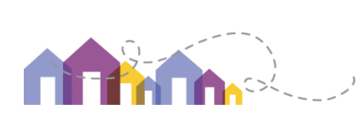

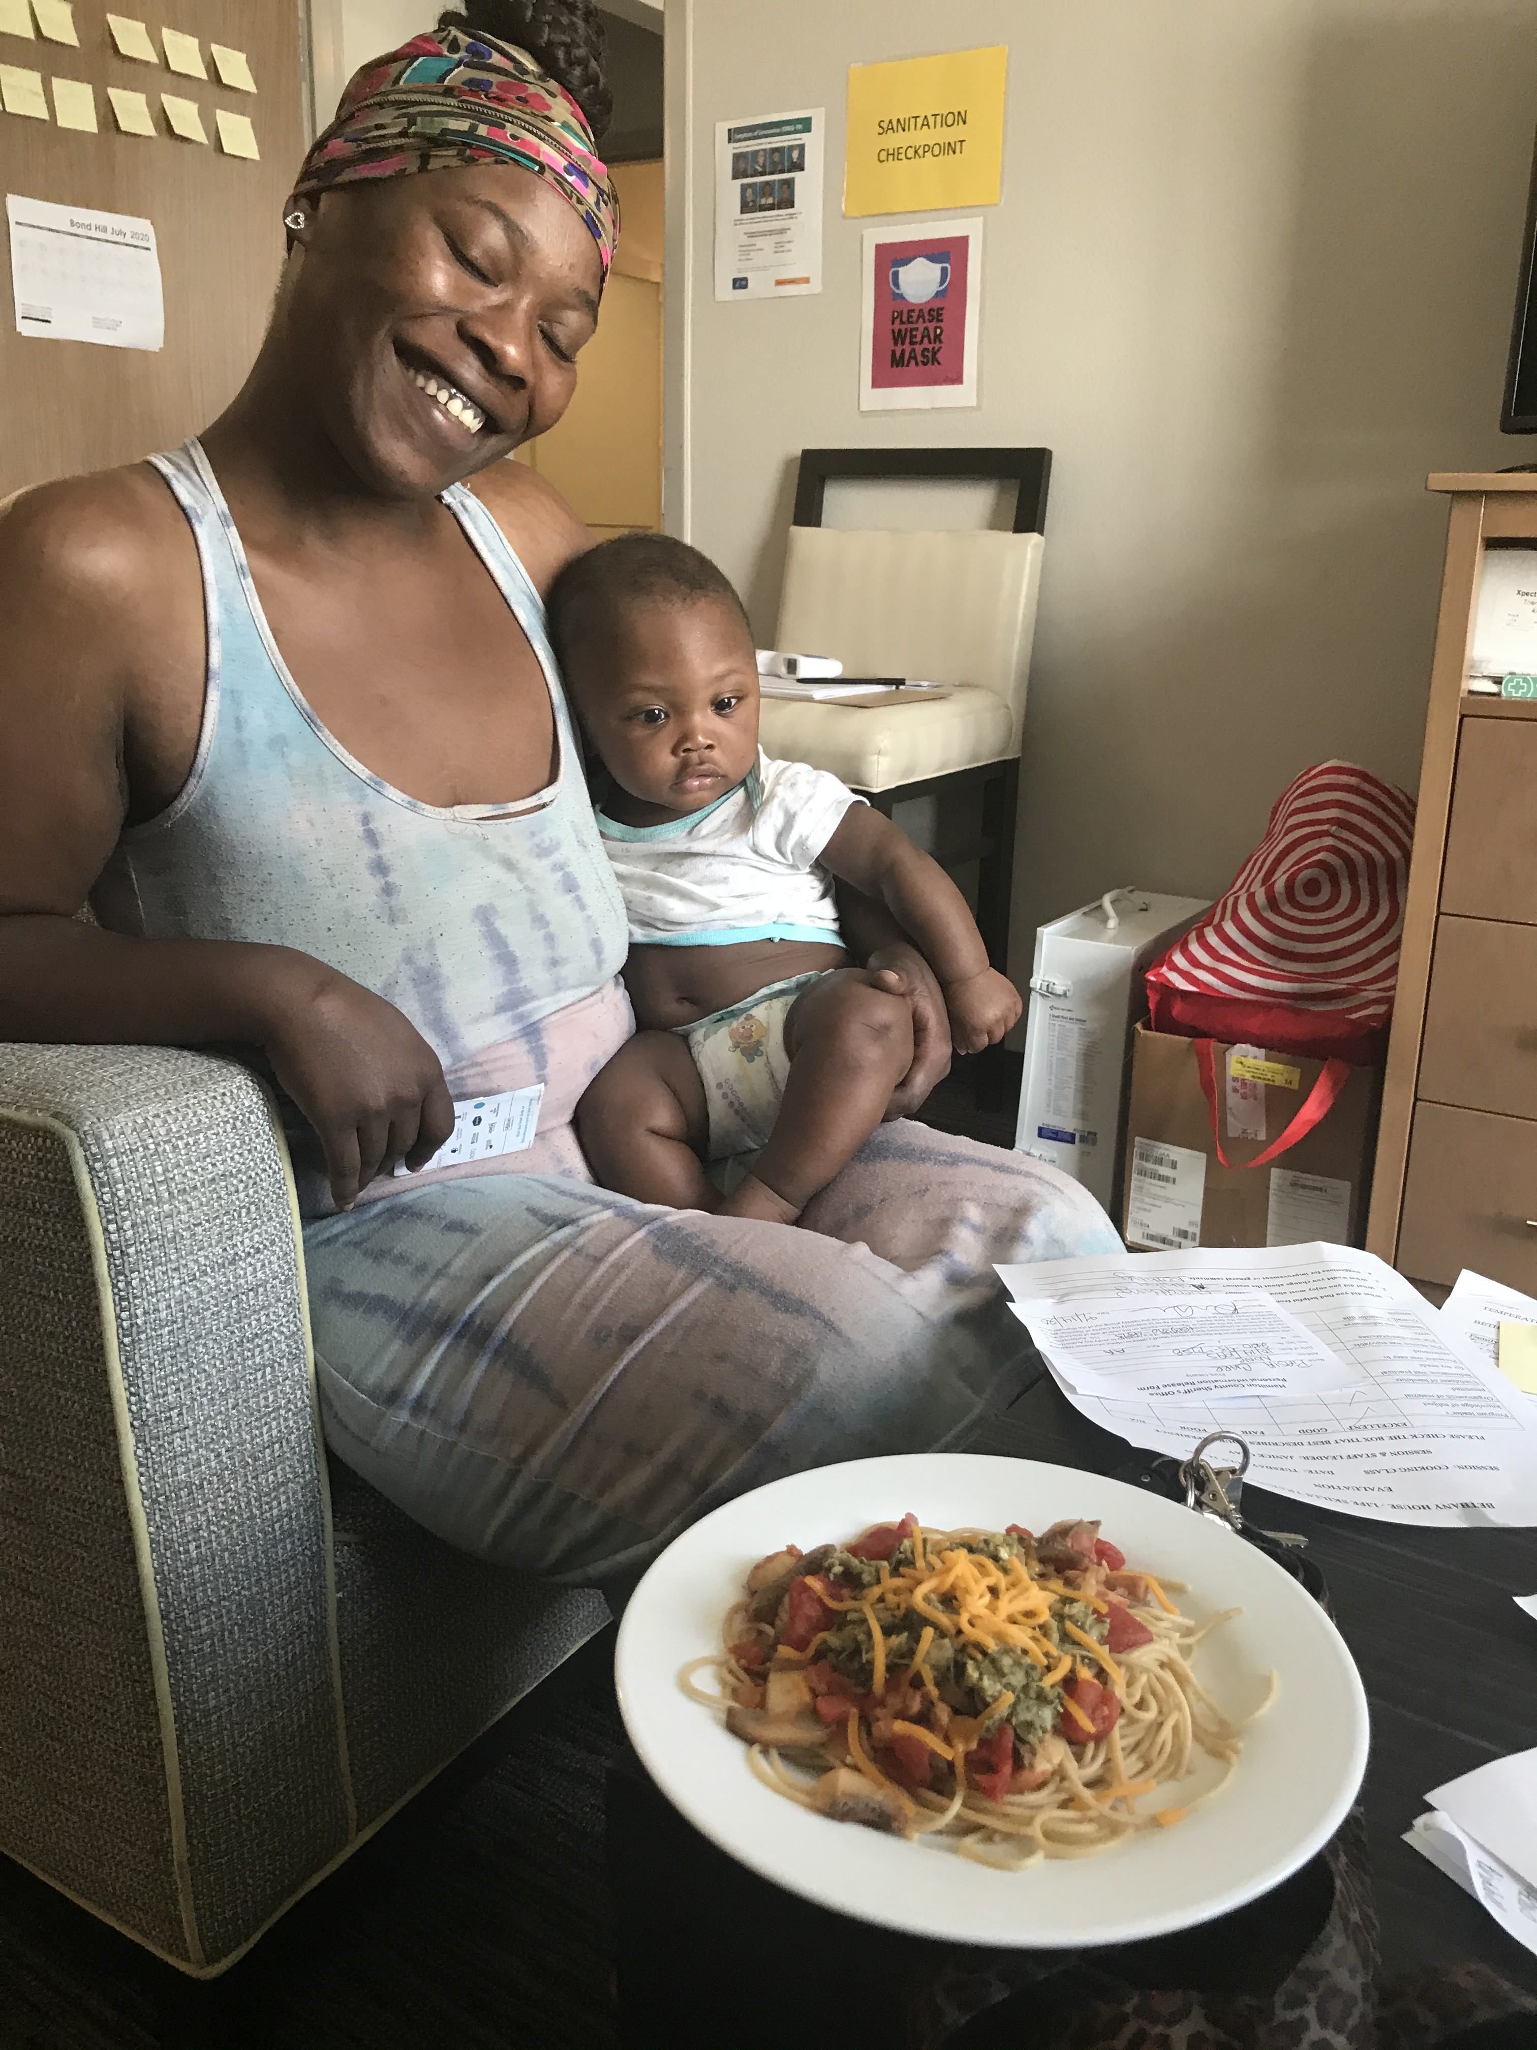
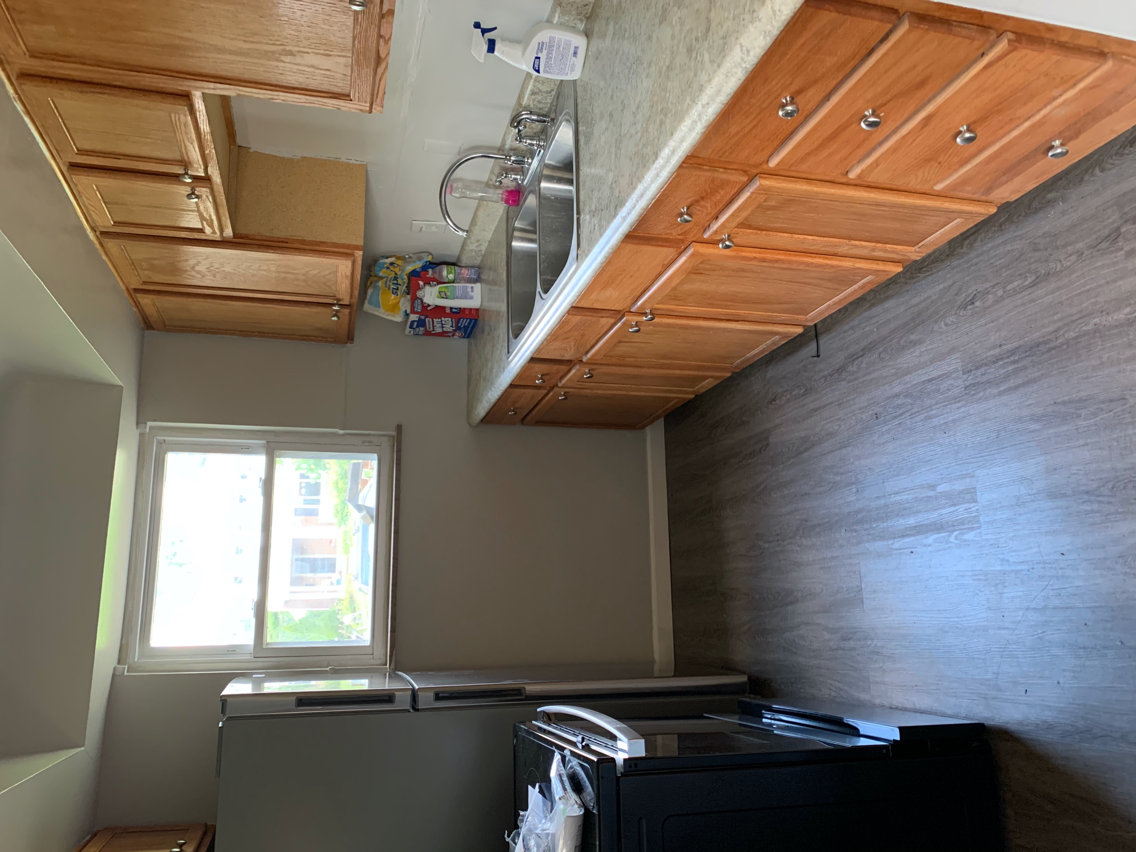
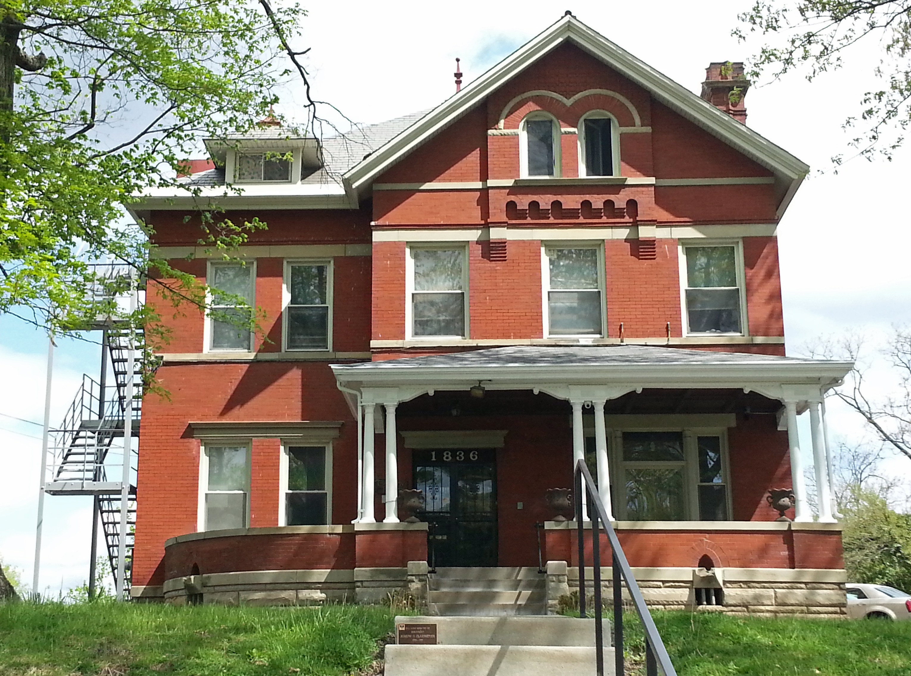

Improving Health Literacy and Hygiene of
Homeless Families at Bethany
House & Elevating Voices of the Homeless Maura Kopchak, University of Cincinnati College of Medicine
Mission of Bethany House Services:
Bethany House Services is a homeless shelter for families that serves the Greater Cincinnati area. The goal of this shelter is not only to provide families with housing stability but also to teach them valuable skills and practices for life-long stability for themselves and their children. We are currently at capacity with 36 families. Bethany House is a low barrier inclusive shelter. We take all forms of family structures. Any adult with custody of their children can stay at Bethany House. Placement at Bethany House is through the Central Access Point Line (CAP Line) which assists with placement throughout Cincinnati’s homeless shelters. The typical length of stay is 45 days.
Roles and Responsibilities:
Assist with case management and Life Skills Courses
Go on housing tours and inspections
Get police reports and assist clients with resumes, applications and finding housing
Connect clients with local resources that assist them financially as they transition out of homelessness
Project: Health Literacy and Hygiene
Identified local resources for medical care, mental health services, and food
Create and distribute health and hygiene booklets at a basic level to help families feel in control and knowledgeable about their health so they can better advocate for themselves
Create posters to connect families with resources
Project: Elevating Voices of the Homeless
Took residents to city council following the protests to advocate for better funding and to express their thoughts and feelings
Held a discussion series to discuss their homeless experiences, their experiences with covid-19, and the experiences with marginalization at the hands of police, city officials, the public and medical professionals
Goal was to educate staff, donors, and the city on valuable resources and gaps
Encouraged residents to register to vote to continue to advocate for themselves and their children
Acknowledgments:
I would like to Urban Health Project for this awesome opportunity to connect with the community. I would specifically like to thank Eunice Agyapong and Maddy VandenBrink for their support throughout the summer. Most importantly, I would like to thank the staff of Bethany House Services for welcoming me with open arms especially Janice Clay and Gwen Green.

Slide 3
.

Slide 4
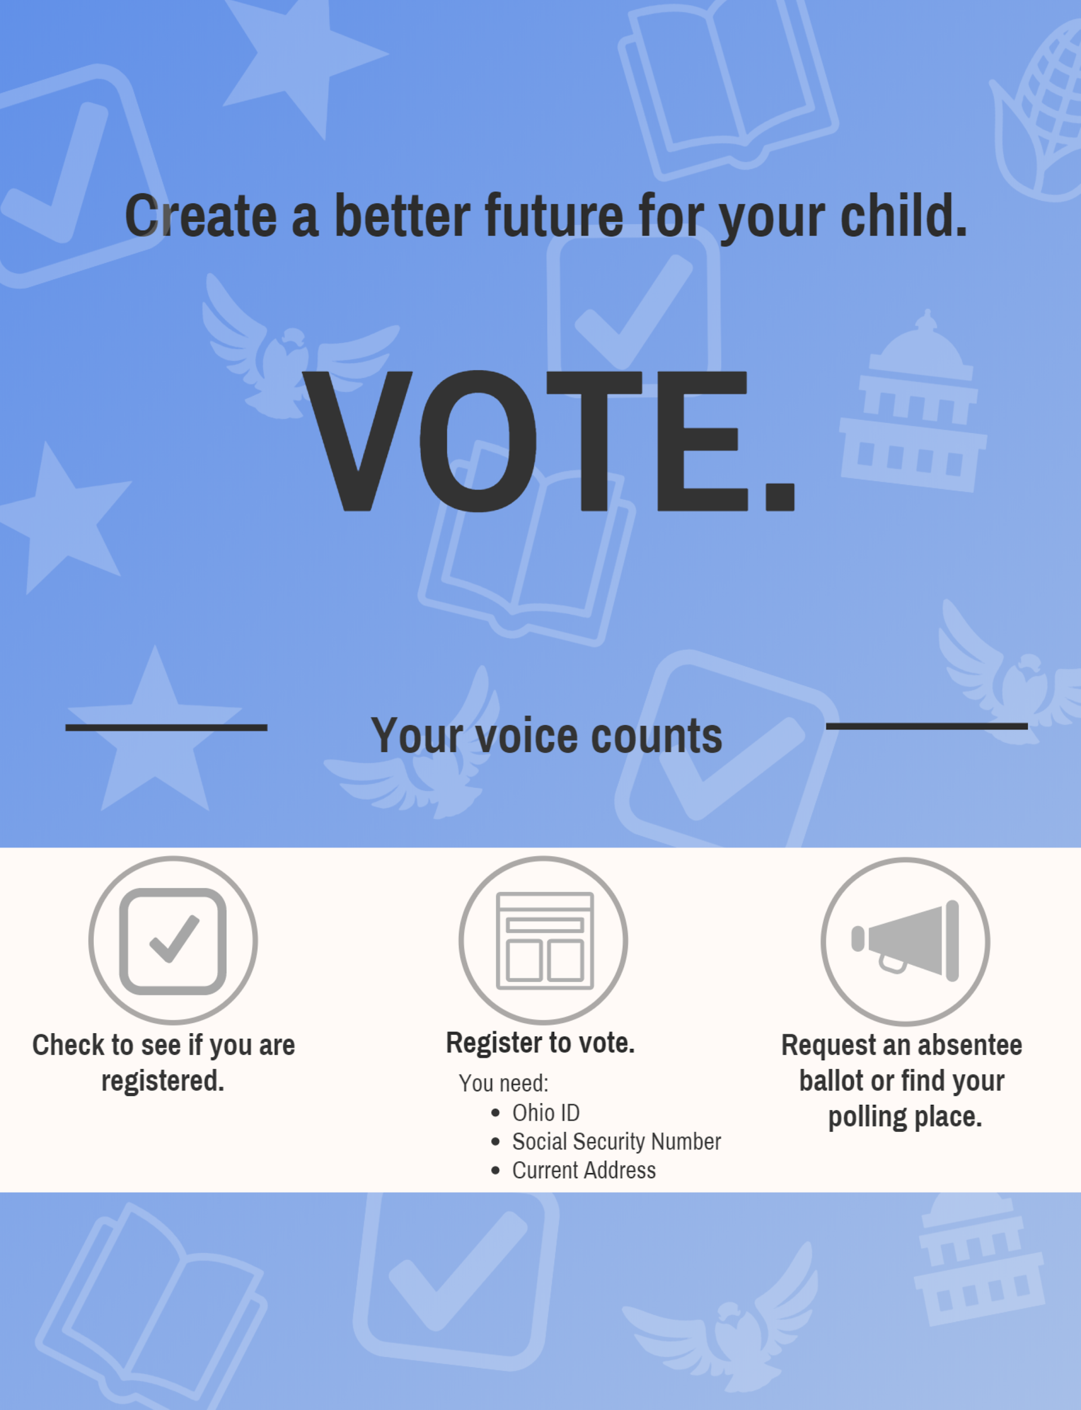
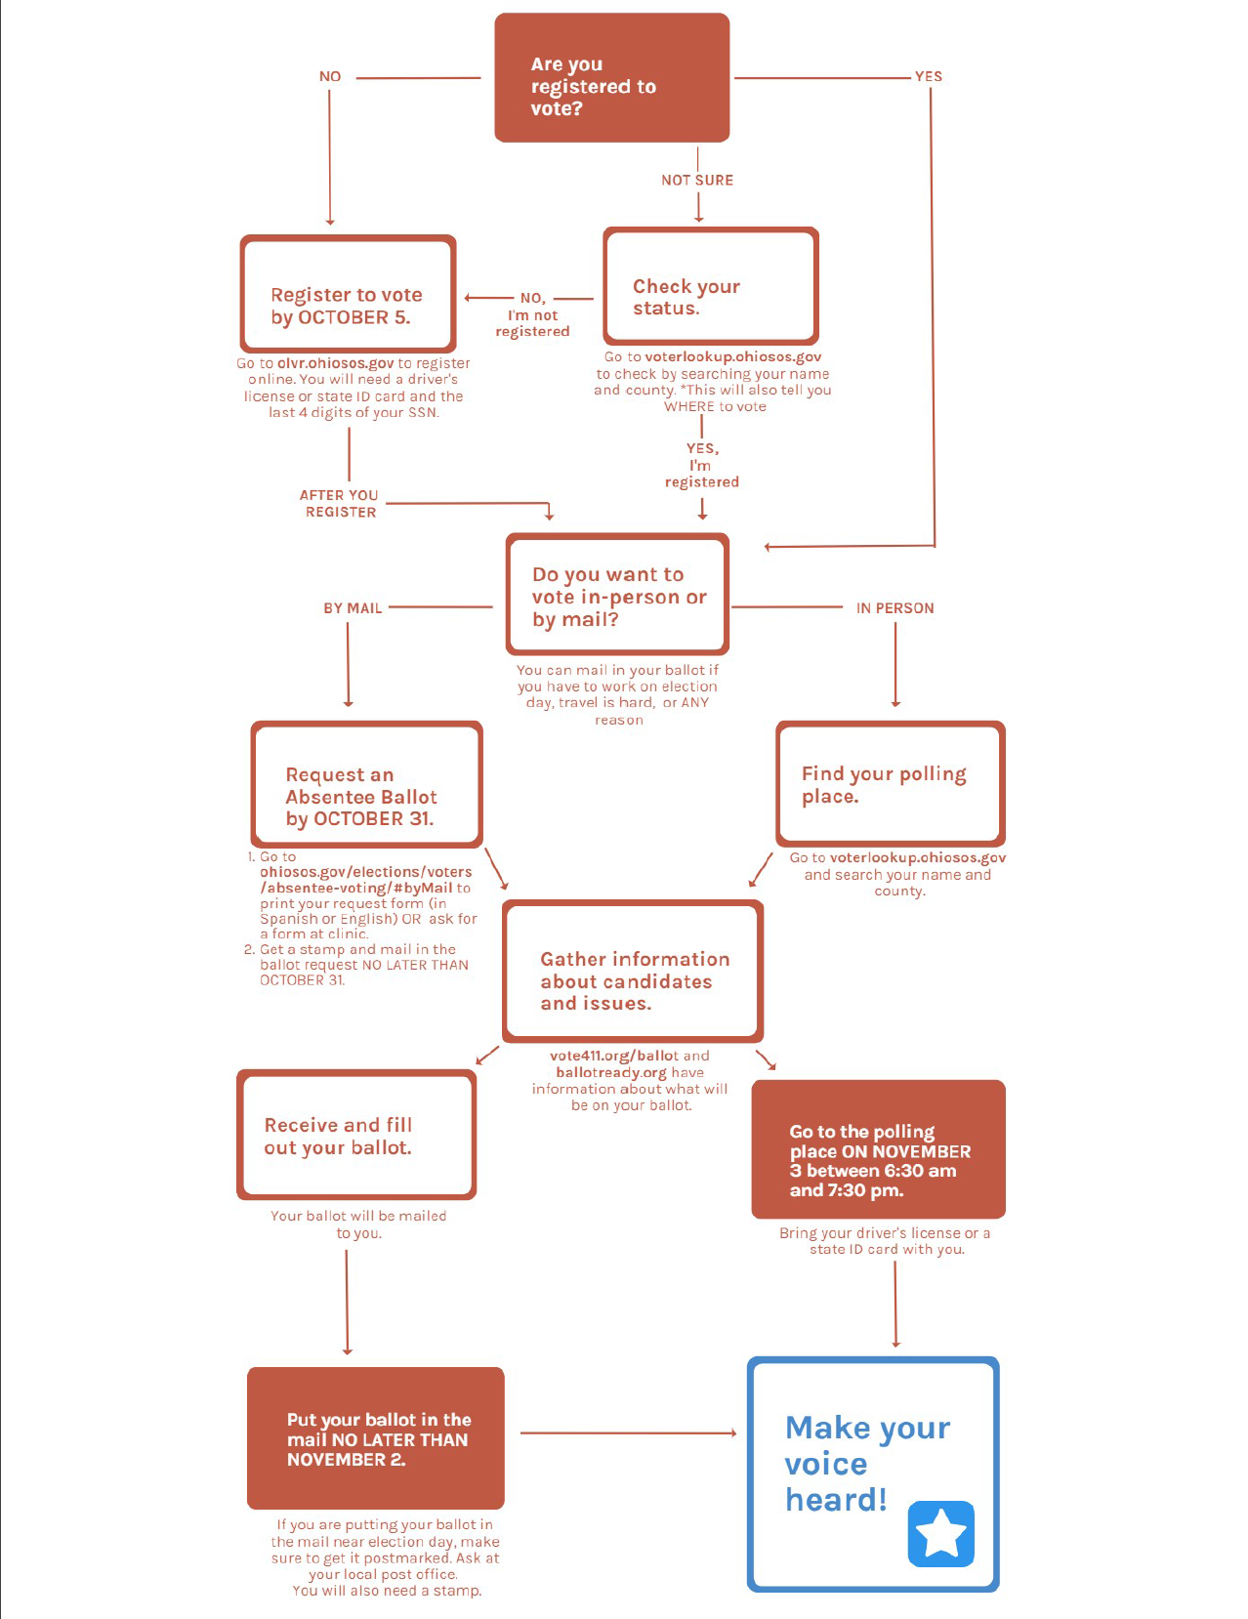
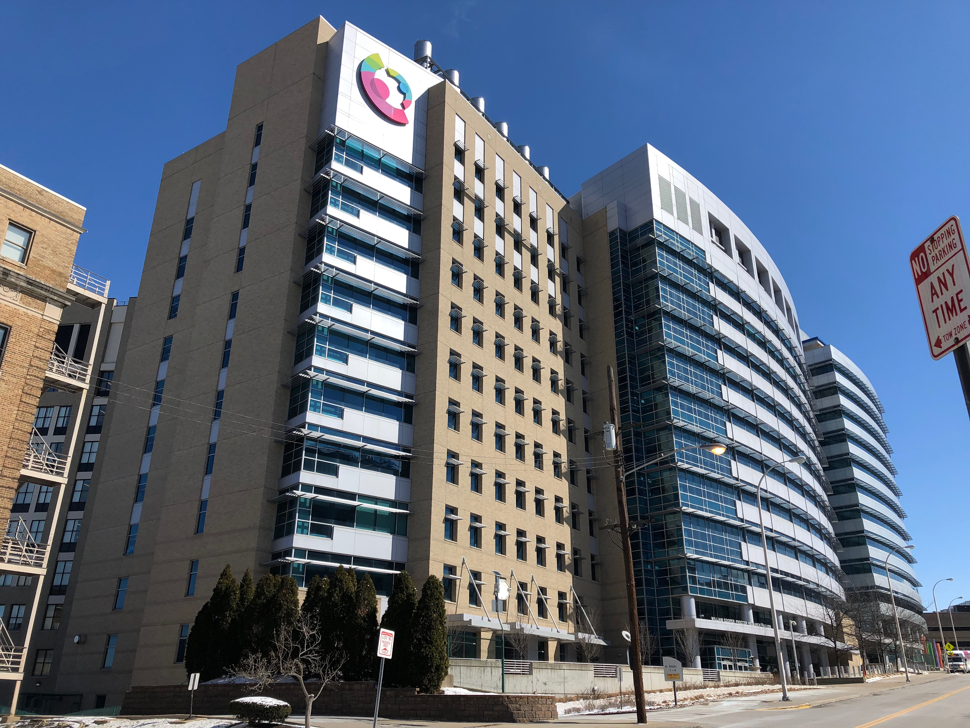
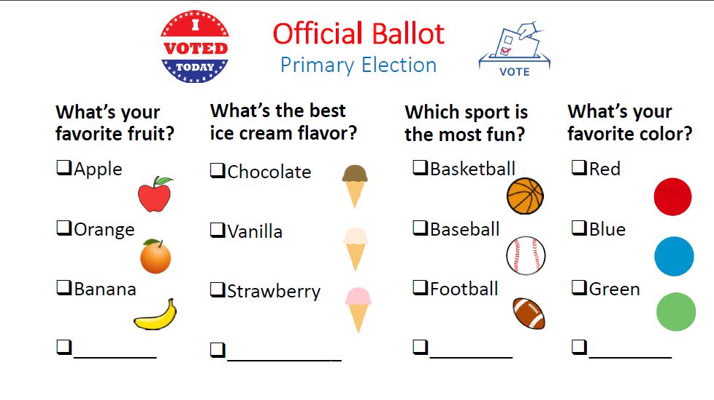
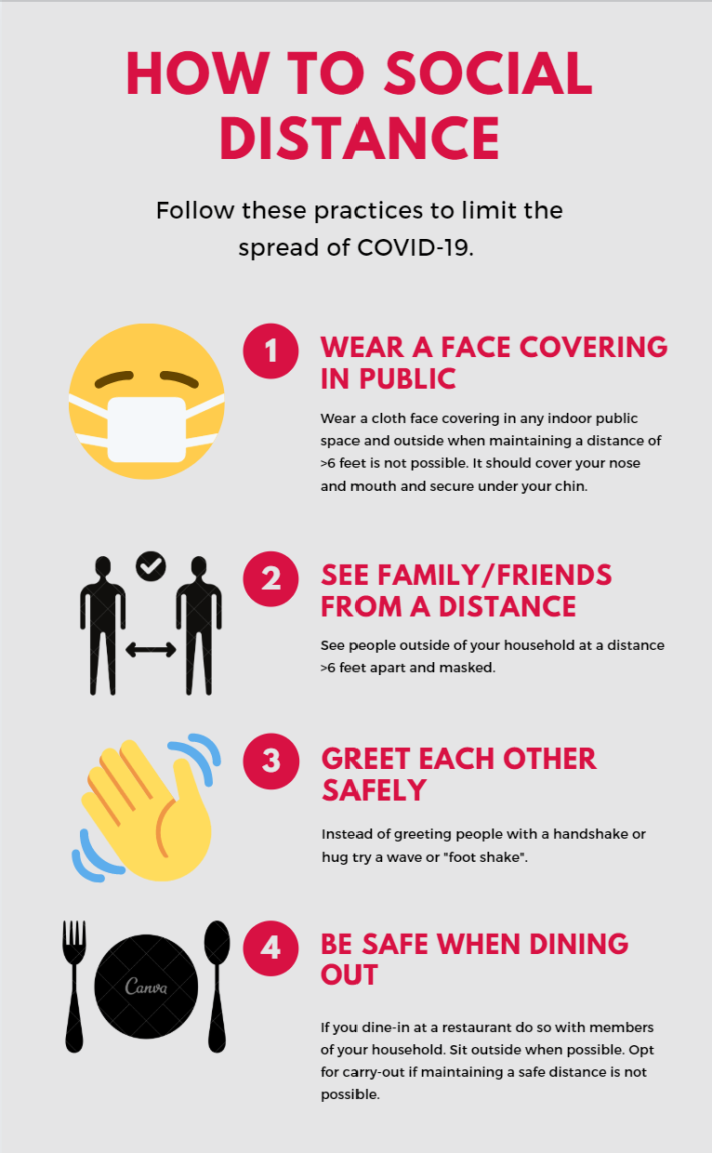
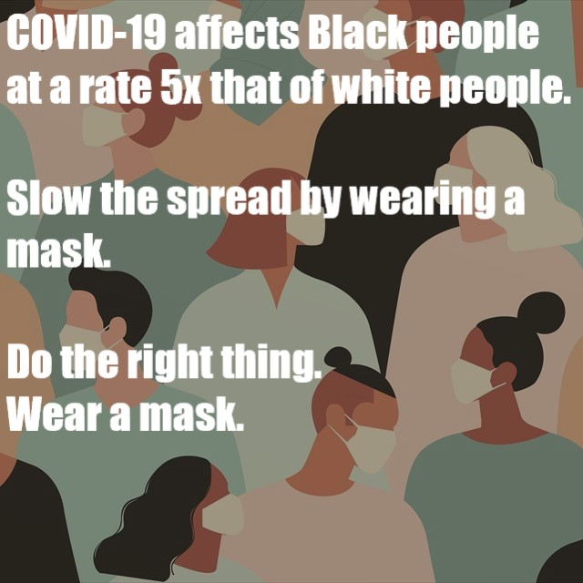

Cincinnati Children’s Pediatric Primary Care
Grace Kelly and Yoni Segev, University of Cincinnati College of Medicine
About the PPC
It is a Federally Qualified Primary Care Clinic located on the Children’s Burnet campus
19,000 patients, and 37,000 visits/year
90% Medicaid
70% underrepresented minority (primarily African American)
5% Hispanic
Committed to providing equitable care for families of different backgrounds and promoting equity throughout the hospital and community
Patient Family Advisory Board
Children’s hospitals around the country often have an advisory board to represent the interests of patients’ and families. This project aims to identify the diversity of different advisory boards across the country and identify strategies which promote equitable representation. A survey has been developed and sent to various Children’s hospitals.
Voting Research and Promotion
Part 1: Examine the correlation between voting as a marker for social capital and child health outcomes. We are running this analysis using data from the Hamilton County Board of elections and Children’s EMR data.
Part 2: Promote voting through pediatric clinics with educational materials, by offering registration, and by providing absentee ballot request forms in clinic.
Patient Family Experience Survey
Preliminary studies have shown that minority populations are more likely to not feel safe after visiting Children’s hospital. Our aim is to identify patterns in Patient Experience surveys to find areas for intervention to improve minority experiences.
Messaging
One challenge of working with diverse populations is messaging to diverse populations in a way that is sensitive to their unique experience. We created a short YouTube video explaining signs of dehydration and heat stroke in children. We also developed materials to promote mask wearing and racial equity action among young adults.
Our Summer Work
This summer, we had the opportunity to be involved in many daily zoom “task-forces,” all of which were comprised of a rich variety of inter-professionals. Sometimes we acted as wallflowers, but often we were able to bring a student’s perspective. Some of these calls were related to projects that we participated directly in, and some of the calls were community initiatives we had the honor of sitting in on.
Acknowlegements
We would like to thank Dr. Beck for patiently helping us navigate this process with all the unexpected features that COVID brought. We would also like to thank Eunice and Maddy for being understanding and supportive of our projects

Slide 5
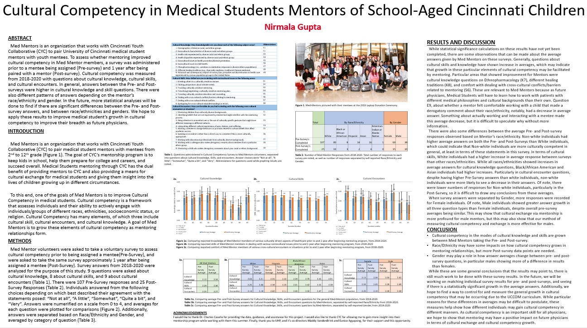


Slide 6
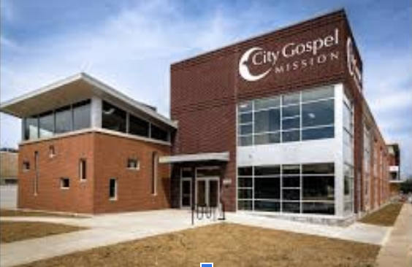

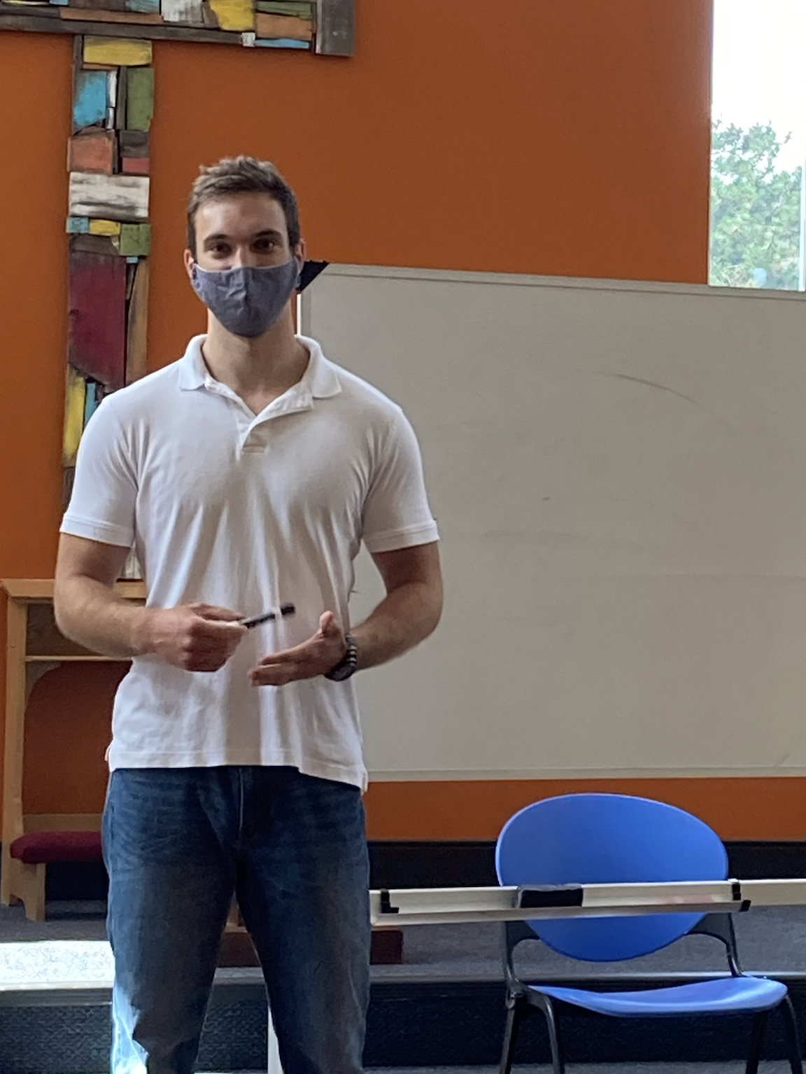

City Gospel Mission
Matthew P Altman, University of Cincinnati College of Medicine
About CGM
For nearly a century, since its founding in 1924, City Gospel Mission (CGM) has served those in need around Cincinnati.
CGM has a wide range of programs that cater to individuals at all stages of life including the “Little Village” for children, addiction recovery “Exodus” program, and the men's shelter.
Life After CGM
With the help of CGM, nearly a quarter of residents successfully transition to sustainable housing and remain off the streets beyond two years.
Staff keeps in touch with former residents over the phone.
Discussion
Classes were routinely at classroom capacity and were well received. Residents were very engaged in presentations, and our discussions regularly exceeded the scheduled class time. After the COVID classes, I noticed that some residents began wearing masks around the shelter--something residents were not doing when I began. It is my hope that these classes spread awareness of chronic illness and helped residents to understand the threat of COVID-19.
Project Description
As part of the day program I taught health education classes
Classes were taught multiple times per week and focused on the health and wellbeing of residents
Topics included chronic illnesses such as diabetes, hypertension, and a weekly discussion about COVID-19 emphasizing mask usage and social distancing.
Men’s Shelter
CGM men’s shelter holds up to 74 residents
Residents are required to either have employment or attend classes as part of the “Day Program”.
Residents receive 3 meals each day.
Dinner is served to the community every night.
Residents may stay for up to 1 year and work closely with a case manager to make a sustainable transition out of homelessness.
Acknowledgements
Special thanks to Kyle Gulley for coordinating the UHP CGM internship as well as the rest of the staff at CGM

Slide 7
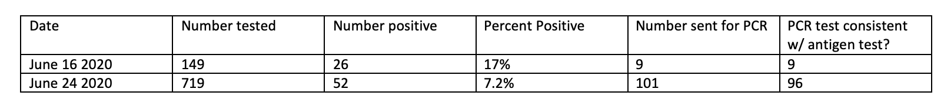
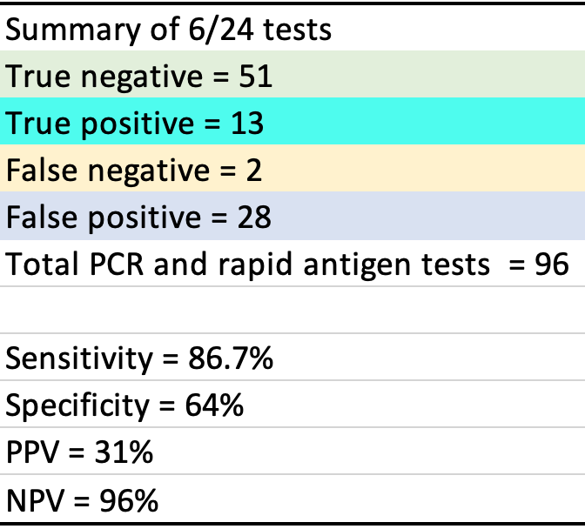

COVID-19 Testing at Crossroad Clinics
Ashley Mills & Kyler Wilson, University of Cincinnati College of Medicine
Introduction
Covid-19 first surfaced as a pandemic in 12-31-2019, [1] and the United States currently holds about 3 million cases [2]. There have been 3,133 confirmed cases in Cincinnati alone [3]. According to the CDC, minorities living in poverty are the most impacted with non-hispanic blacks and hispanics being at least 5 and 4 times, respectively, more likely to be hospitalized with Covid-19 than non-hispanic whites [3].
Crossroad Health Center (CHC) is a community health clinic devoted to providing quality and affordable care to the residents of Cincinnati. The majority of the clinic’s patients live 100%-200% under the federal poverty level. Many of the patient population is composed of non-hispanic black and hispanic individuals.
The clinic has been performing free drive-thru/ walk up COVID-19 testing over the past several weeks for hundreds of patients. Any patient who arrived for testing was tested regardless of insurance status, legal status, or if they were currently patients of CHC.
As part of our internship we were asked to help with some of the administrative tasks of the COVID-19 testing such as organizing patient records, contacting patients, and data entry. In addition to this, we were tasked with aiding patients who do not have a PCP establish care with a CHC PCP.
Methods
We were tasked with compiling the registration forms from the testing days. The paperwork we processed were from test day 06-16-2020 (N=149 forms) and 06-24-2020 (N=719 forms). This included separating the positive patient forms from the negative patient forms and then separating those with a PCP from those without one.
We then contacted the patients who tested positive to check on them. If their condition was poor, via patient self-declaration, we connected them with a nurse in the clinic regardless if they were a CHC patient or not.
For the patients who had PCPs, regardless of test status, we identified their PCP’s fax number and sent a copy of the patient’s result via fax
For the patients who noted they had no PCP, we called them using the phone number on the registration sheet and determined if they wished to establish care with a PCP at CHC. If they did, then their registration form was passed to the front desk who would contact them at a later time.
The registration forms were then attached to their fax receipt, if there was one, and filed in alphabetical order.
In addition, information from the registration forms of patients who received additional PCR testing by the Ohio Health Department (ODH) was inputted into a spreadsheet for tracking.
After several days the PCR results were received and patients were contacted via phone calls with COVID status updates based on these new results. .
Results
Between the two days of testing 868 patients were given antigen testing at the OTR CHC site, 149 being tested on the first day, and 719 being tested on the second. Of these patients 78 tested positive (9.0%). It should be noted that over twice the percentage of patients (17%, 26 individuals) tested positive on the first date during the antigen screening compared to the second testing date (7.2%, 52 individuals). Of all 110 test results sent for PCR analysis 105 came back consistent with the antigen test results (95%) denoting the relative accuracy of the antigen test. The statistical analysis of the second date can be seen in table 2. Of note is the second sate’s a sensitivity of 86.7 and NPV of 96%. The statistical analysis of the first testing date was not made available to us.
Reflection
During our time volunteering with CHC we both experienced some of the positives and negatives of primary care and how a health crisis can affect an office. Below are some points of interest we felt were pertinent to discuss:
Problems with contacting the Ohio Health Department delayed receiving antigen and PCR test results. Prior to this experience, we were unsure of the logistics of the practical relationship between a primary care office and the state health department. We were surprised to find there is no designated contact person in the ODH and the process was mostly mediated through phone calls and paper. Initially, it was thought that the results would be stored electronically but that was not the case and this allowed for the misplacement of patient results.
The hecticness of Drive-thru testing was also demonstrated by many files having “NO PCP” written on them but when patient’s were contacted, they did have PCPs. We were told by clinic administrators that they were not expecting the volume of patients they were getting and the test sites quickly became overwhelmed
It was impressive that CHC took the extra steps to check up on positive patients and reach out to patients who do not have a PCP. Despite being overwhelmed with the sheer volume of paperwork the testing alone created, the clinic still prioritized ensuring that those who tested positive were doing well. In addition, CHC’s willingness to increase their patient population despite the increased trails the clinic is facing due to COVID-19 is admirable.
We were impressed by CHC commitment to creating a workflow to speedily process and contact patients about testing results. Despite the unexpected timing and severity of the pandemic, the staff at CHC have continued to focus on maintaining patient health and adapting quickly.
Future Considerations
This service project allowed CHC to reach out to patients while not adding an additional burden to their already overburdened staff. Reaching out to patients to check up on them, offer them the chance to establish care, and report PCR testing shows the quality of care CHC is providing the community. There is still some areas that could be improved to aid similar endeavors in the future.
While this is not solely a CHC issue, the pandemic displayed how poorly the ODH is prepared for crisis. It would be imperative to establish clearer and more organized methods of communication between ODH offices and clinics that are managing drive-thru testings. Having this established system can aid in preventing errors and miscommunications that can ultimately impact the health of the community. This can be facilitated via the establishment of a specific liaison team formed from volunteers and only activated during times of crises.
In addition, making the transition from paper files to electronic records can facilitate easier communication and sharing of data. Equipping drive-thru testers with technology such as computers or tablets to record information allows that the data can be shared between the ODH and clinic easily. Encryption technology exists to protect PHI during this transfer of information.
It could also aid CHC and other clinics conducting drive-thru testing to advertise a service opportunity to medical students. While there might be restrictions about students doing the actual testing, there are ways to protect the students while the handle the paper processing. This will also alleviate the burden on the clinic staff while ensuring that the quality of care CHC wants to provide is not compromised.
References
Archived: WHO Timeline - COVID-19. Who.int.
https://www.who.int/news-room/detail/27-04-2020-who-timeline---covid-19?gclid=CjwKCAjwjLD4BRAiEiwAg5NBFoDNrlbRW3saiRFk_bZx-1g_HqOtV0KLt6KauGOFNurXYOBIOBh47RoCY9sQAvD_BwE. Published 2020. Accessed July 15, 2020.
Coronavirus Disease 2019 (COVID-19). Centers for Disease Control and Prevention.
https://www.cdc.gov/coronavirus/2019-ncov/need-extra-precautions/racial-ethnic-minorities.html. Published 2020. Accessed July 15, 2020.
Department H, Tracker C. Cincinnati COVID-19 Case Tracker. Cincinnati-oh.gov.
https://www.cincinnati-oh.gov/health/covid-19/cincinnati-covid-19-case-tracker/. Published 2020. Accessed July 15, 2020.
Table 1
Acknowledgements
We would like to extend our thanks to Dr. O’Dea for offering us this opportunity and for her support throughout the project.
We also extend out gratitude to our site supervisor Kaitlyn Christman, who despite this being a project she was not familiar with offered assistance to us at every step.
Table 2
*Above data and calculation provided by Dr. Chrstine O’Dea

Slide 8


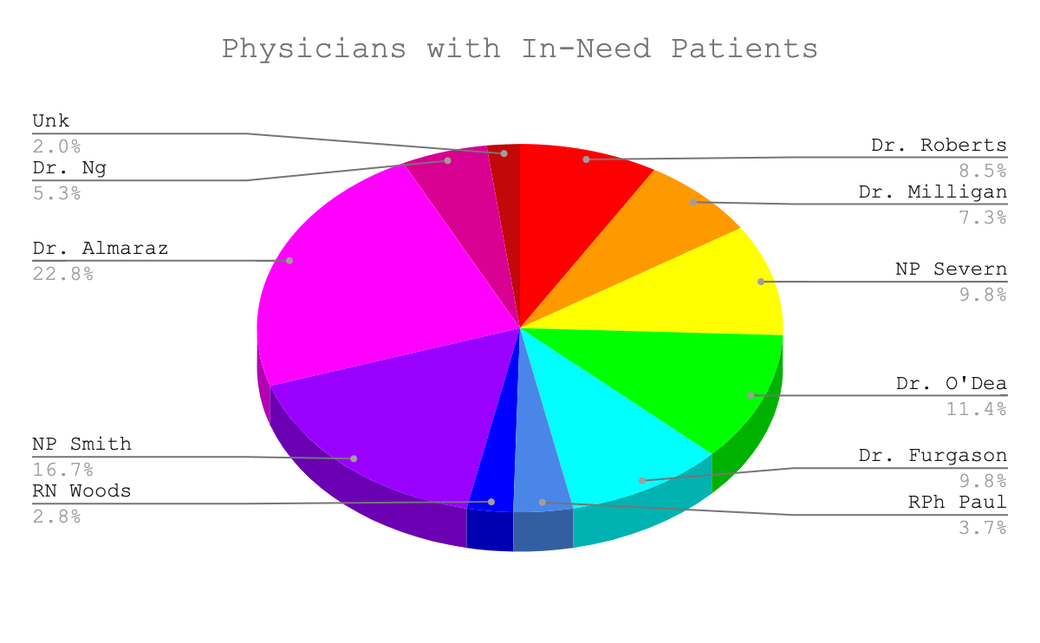
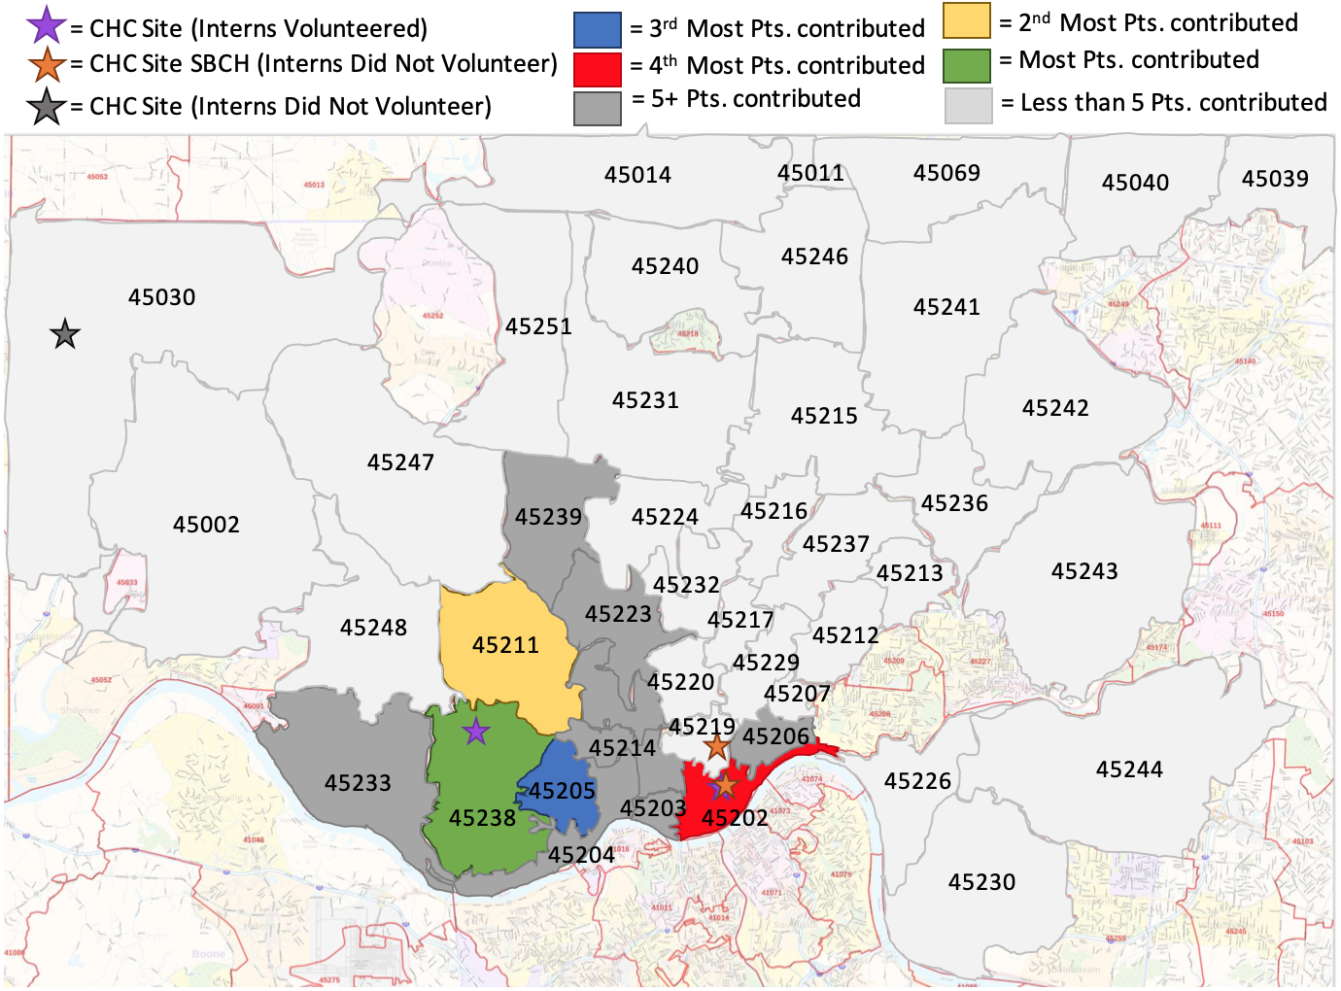
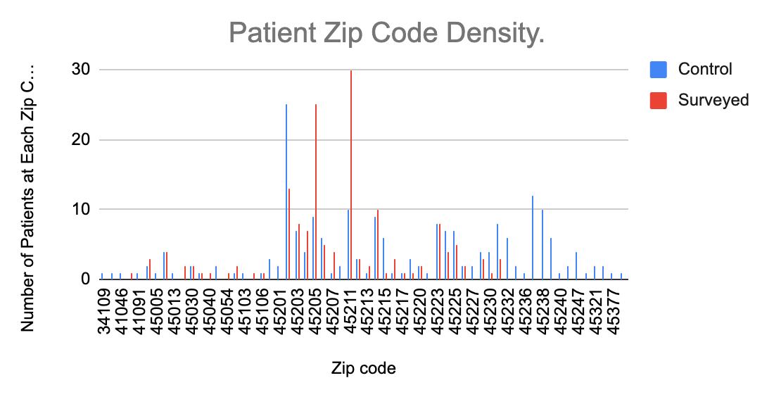
Social Determinants of Health at Crossroad Clinics
Alex Gillotte, Ashley Mills, Kyler Wilson
University of Cincinnati College of Medicine
Introduction
A person’s health outcomes are determined by a multitude of factors outside of the immediate physical ailments. The concept of the Social Determinants of Health (SDOH) is an attempt to describe this reality. The CDC defines the SDOHs as “conditions in the places where people live, learn, work, and play” that can affect a person’s health and health outcomes [7]. SDOH can vary greatly between any given patient resulting in unique impacts on their health. Its impact on patient health outcomes, makes SDOHs an important field of study especially in a preventative primary care setting like the Crossroad Health Center (CHC).
CHC is a community-based multi-location healthcare system that serves mostly lower income citizens of Cincinnati. Many of the patients experience extra-medical issues that can negatively affect their health outcomes. With this in mind, Crossroad Health Center began screening for SDOHs as part of the Centers for Medicare and Medicaid Services’ project: GEN-H Connect. The goal of GEN-H Connect is to determine if healthcare spending could be reduced by screening Medicare and Medicaid beneficiaries for SDOH and connecting them with appropriate local resources [6]. The current screening accounts for the following SDOHs: housing, food security, transportation, utilities, and safety/abuse.
Language barriers is another SDOH, one that is not addressed by the Gen-H Connect screening, and is often overlooked leaving patients who are unable to fluently speak English with “unequal access to healthcare and unequal health outcomes” [1]). According to the Census Bureau, Latinx individuals are the largest minority group in the US and over 40 million individuals speak Spanish [2]. Language barriers lead to unequal health outcomes not just because it causes unequal access to healthcare, it also prevent Latinx individuals from accessing social services that others can. Social services such as the ones provided via the GEN-H Connect Project. CHC serves many Hispanic patients and while they receive quality care from the bilingual medical staff, their access to social services from the GEN-H Connect Project is inconsistent as it depends greatly on the availability of interns who speak Spanish.
As UHP Interns we were tasked with calling patients to administer the SDOH screening and compiling data with the following objectives in mind:
Identify the zip codes with the largest patient population in need of assistance
Identify the most common SDOH with which patients need assistance.
Identify the physicians who work with largest patient population in need of social services.
Our hope with these objectives was to find trends in the data in order to create and implement interventions at Crossroads clinic to increase utilization of local SDOH resources. Since we wanted all of Crossroads patients to benefit from these interventions, the screening and all local SDOH resources were translated to Spanish. We also assisted in changing UHP policy for intern placement and with the development of a volunteer program that will allow Medical Spanish/ Latino Health Elective students to assist UHP sites throughout the whole year.inic that will potentially preemptively increase utilization of local SDOH resources.
Methods
Patients at Crossroad Clinics over the age of 18 from a select set of providers were screened. Calls (M=1124) were made between the dates of 6-9-2020 and 7-10-2020 in order to conduct the screening (N=456).
We utilized the CMS survey which consisted of 13 questions ranging from housing needs, food insecurity, utilities needs, to interpersonal abuse and violence. Patients who consented were screened regardless of insurance status. All patient responses were recorded in their chart on the EHR Athena under Social History. Those who have Medicare/Medicaid also had their information saved on Healthify. As there were Spanish speakers on the team this year, patients speaking only Spanish were included in this study. For those who had needs, we compiled a list of resources, using the organization search engine in Healthify, that were then mailed to the address on their chart. If a patient refused to take the survey, their refusal was noted in their chart, and they were considered a NO NEED patient. NO NEED patients were then used as a control group and continuous quality improvement (CQI) measure in order to analyze whether or not patients were having their social determinants of health (SDOH) addressed.
The data for the project was gathered while administering the surveys. Patient zipcodes, PCP, past survey information, and current survey responses were recorded. PHI was de-identified as appropriate.
The data was analyzed using COUNTIF formulations which generate a conditional count among a specified range of a specific logical expression. TO_TEXT was used to prevent spelling/typing errors from affecting the data. Data was analyzed in respects to zip code, resource type, ED visits, and Provider.
=COUNTIF('Raw Data Declined'!A:A,TO_TEXT(E2))
The total number of data points (Ncontrol= 209 and N=246 ) was compared against each section via tautology formulas (X=Y) as an accuracy check of the COUNTIF formulations.
=SUM(F2:F) = B5
To address some of the needs that were identified by the results, we created packets of resources for the heavily impacted zip codes.
In addition, we created a database via Google Docs to hold translated resources for Hispanic patients.
Discussion
The results of this study found many insights that Crossroads could apply to make screening patients more efficient and increase the utilization of local SDOH resources by patients. Using the top needs of patients, medical providers who work with and the top zip codes with the largest patient population in need of social services Crossroads can create a flagging system in Athena (an EHR) to allow patients most at risk to receive assistance before stepping foot in Crossroads.
Currently, Crossroads does not have the operational workforce or funds to effectively survey all patients more than every couple months, and Spanish speaking patients are surveyed even less. Therefore, creating a flagging system can ensure that those most at risk receive help in a more timely manner. It is also the reasoning behind assisting with the change in UHP policy for intern placement and developing a volunteer program that will allow Medical Spanish/ Latino Health Elective students to assist UHP sites throughout the whole year. These two things will ensure that not only will Crossroads have volunteers to assist with their workload but also guarantees Spanish speaking patients are screened more frequently.
In order to preemptively address the needs of all patients at Crossroads and utilizing the zip codes with more than 10 patients, pre-made resource packets were made. These packets can be printed off by any Crossroad employee, if asked by a patient and they can be made available online on Crossroads so that resources are accessible to patients 24/7. Resource packets were also translated in Spanish so that Spanish speaking patients as well can access them.
While this study will help increase the accessibility of social services for patients at Crossroads there were still limitations. One limitation is that patients who speak another language besides Spanish and English are not being given the SDOH screening as frequently as they should be, if at all, because it depends on the availability of volunteers who speak that language. Another limitation was that the surveys were administered solely over the phone due to COVID-19. Normally, the SDOH screening is given to patients in person before their appointment which gives all patients a equal chance of being surveyed. Meanwhile, during the length of this study calls were made during business hours leading to unequal chances of the patient being given the survey. However, some patients prefer being given the survey over the phone as it allowed for increase flexibility and gave patients who frequently change their appointment or miss appointments a chance to have their social needs (factors which a majority of the time are the reason for the patients no-shows or constant changing of appointments). Due to this it has been recommended to Crossroads to adopt a hybrid model for screening patients. This model will allow patients to mark their preference of how they would like to be surveyed in the future (either in person or over the phone), to ensure equal chances of patients being surveyed and hopefully increase response rates.
Future Considerations
This study has allowed for an increase in range of patients who can receive the SDOH survey and benefit from the resources provided, however there is still room for improvement. Moving forward, it may be beneficial to expand the volunteer program being set up to include medical students who speak other languages besides Spanish or English. This will allow non-English and non-Spanish speaking patients to receive the SDOH screening and resources.
To increase the amount of patients taking the survey, in the future it might be beneficial to advertise in Crossroads Health Center and on their website about the SDOH screening and why it is important for the overall well-being of the patients. Doing this will also increase patient autonomy and increase the patients participation in their care and encourage them to vocalize not only their social needs but their medical needs as well.
One way to address the lack of volunteers to administer the survey, in addition to the volunteer program that was set up, would be to ask the medical staff and/ or the staff in reception to ask all patients if they need any assistance with food, housing, utilities, transportation, and safety/abuse. If this is an inefficient method, then the assistance question could be provided as check-in paperwork, where if a patient selects they need assistance with any of the items listed, that can be flagged so that a volunteer can administer a SDOH survey and that patient can be provided resources at their visit. This would allow for more consistent or regular screening of patients for SDOH.
References
1. Al Shamsi, H., Almutairi, A., Al Mashrafi, S., & Al Kalbani, T. (2020, April 30). Implications of Language Barriers for Healthcare: A Systematic Review. Retrieved July 13, 2020, from https://www.ncbi.nlm.nih.gov/pmc/articles/PMC7201401/
2. Bureau, U., 2020. Hispanic Heritage Month 2017. [online] The United States Census Bureau. Available at:
<https://www.census.gov/newsroom/facts-for-features/2017/hispanic-heritage.html#:~:text=40%20million,residents%20age%205%20and%20older.> [Accessed 13 July 2020].
3. Daniels N, Kennedy BP, Kawachi I. Why Justice Is Good for Our Health: The Social Determinants of Health Inequalities. Daedalus. 1999;128:215-251.
4. Peterson EL, Carlson SA, Schmid TL, Brown DR. Prevalence of master plans supportive of active living in US municipalities. Prev Med. 2018;115:39-46. doi:10.1016/j.ypmed.2018.08.004
5. Babb S, Liu B, Kenemer B, et al. Changes in Self-Reported Smokefree Workplace Policy Coverage Among Employed Adults-United States, 2003 and 2010-2011. Nicotine Tob Res. 2018;20(11):1327-1335. doi:10.1093/ntr/ntx202.
6. Christman K. Gen-H Connect: Social Determinants Screening. 2020
7. Centers for Disease Control and Prevention. Social Determinants of Health. Centers for Disease Control and Prevention.
https://www.cdc.gov/socialdeterminants/index.htm. Published January 29, 2018. Accessed July 15, 2020.
.
Results
During the length of the study a total of 455 patients were contacted. Out of these patients 209 patients declined the survey (this group is considered our control) and 246 took the survey (this group was considered our experimental group). Also out of the 455 patients 28 of them were only Spanish speaking.
Our first objective was to identify the zip codes with the largest patient population in need of assistance. The patients who took the survey were from forty-nine different zip codes living around the Cincinnati area while those that declined were from fifty-five different zip codes. The zip codes shown to have the most need for assistance were 45238, 45211, 45205 and 45202 (having 42, 30, 25, and 13 patients respectively). In comparison, the top zip codes for the control group was 45202, 45237, 45211 and 45238 (having 25, 12, 10 and 10 patients respectively).
Secondly, we wanted to identify the most common SDOH with which patients needed assistance. As the control group didn’t take the survey, the results are solely from the experimental group (patients who took the survey). The top needs reported were food, transportation and safety/ abuse (73, 68 and 95 patients respectively). The safety/ abuse category could be further broken down to patients being insulted/ talked down to by individuals in their life, patients being screamed/ cursed at by individuals in their life, patients being threatened with harm and patients being physically abused (37, 34, 13 and 11 respectively).
Lastly we wanted to identify the physicians/ medical providers at Crossroads that are responsible for the care of the largest patient population in need of social services. From the control group the top medical providers for which patients were assigned to were Dr. Roberts, Dr. Milligan, NP Severn and Dr. Furgason (56, 39, 35 and 30 patients respectively). The top medical providers for the experimental group on the other hand was Dr. Almaraz, NP Smith, Dr. O’Dea, NP Severn and Dr. Furgason (56, 41, 28, 24 and 24 respectively).
Acknowledgements
We would like to thank Kaitlyn Christman for all the support and guidance throughout this project.
We also extend our gratitude to Eunice Agyapong and Maddy Vandenbrink for their constant support as we embarked on our internships.
Finally, we would like to thank Brian Weiner for assisting us with the code for our data analysis and troubleshooting our formulations.
Figure 2: Distribution of in-need patients seen by Crossroads Medical Providers.,
Figure 1: Geographic demonstration of need impacted neighborhoods in Cincinnati OH. Included are the other CHC clinic site location.
Figure 3. Density of Patient of Zip Codes of both Control group and Survey Group.

Slide 9
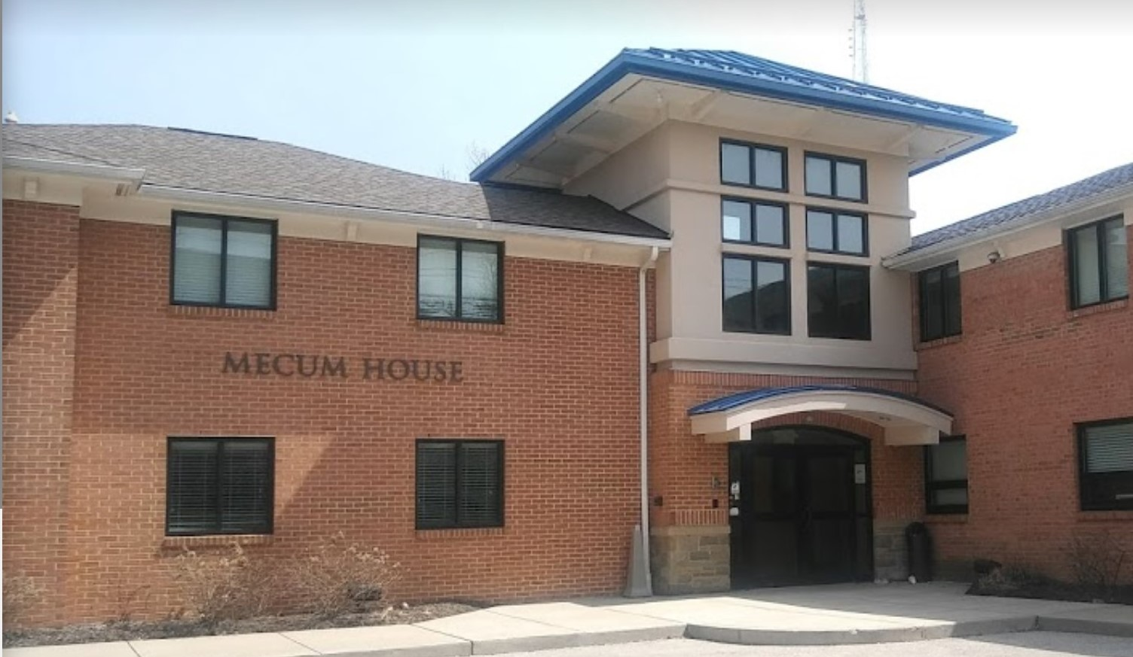
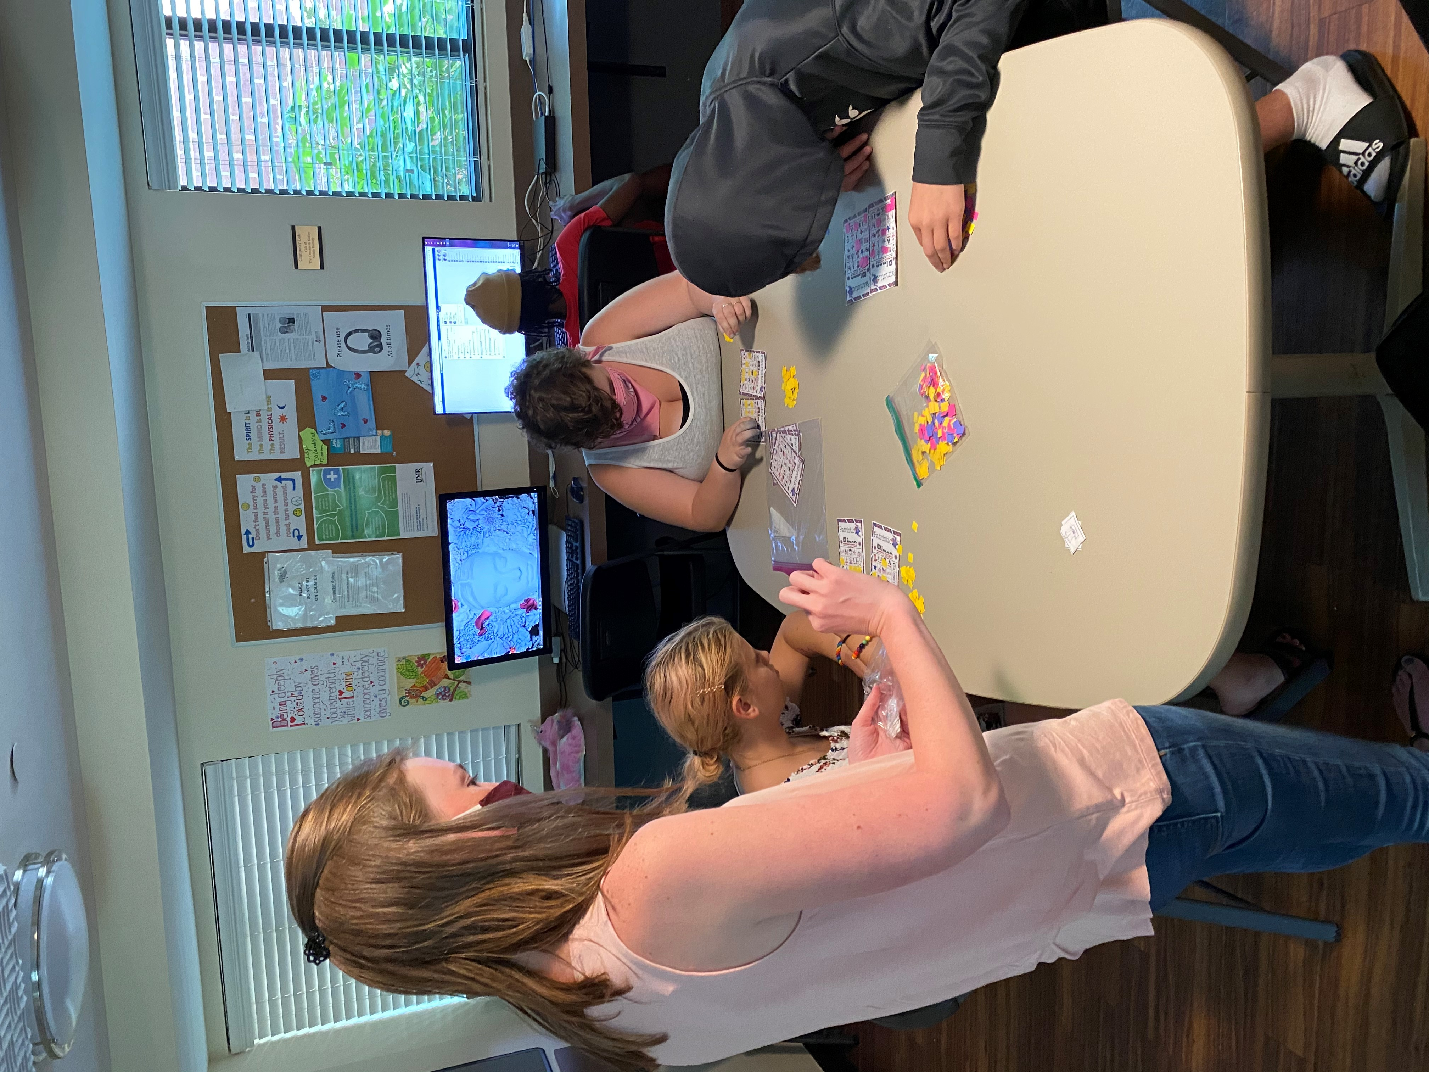
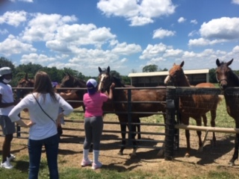
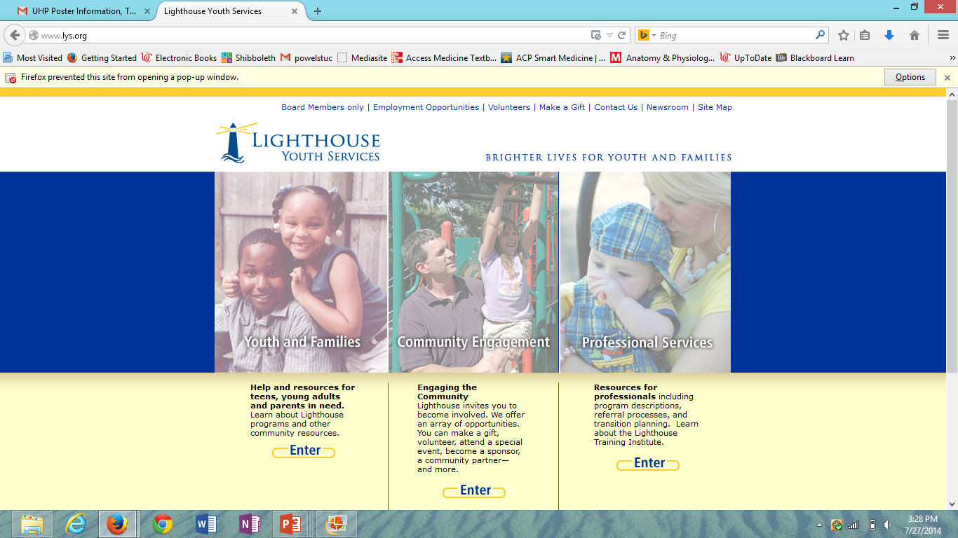
Lighthouse Mecum House
Anna Edwards, University of Cincinnati College of Medicine
About Mecum House
Mecum House provides a safe shelter for youth ages 10-17 who are experiencing homelessness in the Greater Cincinnati Area
Served 467 youth from July 2019-June 2020
Average stay of 4 days
Food, clothing, and toiletries are provided
Youth are assigned to individual rooms where they sleep and keep their belongings
Employees are caring individuals who help make the kids feel comfortable and safe
Employees advocate for the youth through frequent communication with case workers
A Day At Mecum House
In-person workdays: Monday, Wednesday, Friday
8:00 AM – 9:00 AM: Preparation for the daily activity
9:00 AM - 10:00 AM: Wake up call, daily hygiene activities, and breakfast
10:00 AM - 10:30 AM: Yoga class
10:30 AM - 11:30 AM: Free time (opportunity to learn about each person’s interests and hobbies)
11:30 AM - 12:00 PM: Ate lunch with the youth
12:00 PM – 1:00 PM: Group activity
1:00 PM – 4:00 PM: Individual Mentoring and spend time with the youth
Group Activities
Group activities held at least once a day
Kept in mind the group of adolescents was constantly changing from day to day
Focused on education or improvement of physical and mental health
Each morning started with a beginner yoga class streamed from YouTube
Examples of group activities include guided meditation, trivia games focused on hygiene, learning how to play tennis, online strengths assessment, healthy meal planning, visiting a horse farm, nutrition bingo, and arts and crafts.
HEART Binder Project
Acronym for Healthy and Engaging Adolescent Resources and Tools
Printed resource for any volunteer to use
For each activity facilitated over the summer there is a page in the binder with the goals/topic, materials needed, and detailed instructions
Categorized by goal/topic
Allows for continuation of activities focused on mental and physical health after completion of the internship
Individual Mentoring
Time was spent each day getting to know the youth in a one-on-one setting
Quickly built trusting relationships
Identified individual goals and assisted them when needed
Examples of individual activities include workout classes, job searching, discussions about healthy relationships, and education about safe sex
Acknowledgements
I would like to thank David Durr for the resources, guidance, and education he provided to me throughout my internship. I would also like to thank the Mecum House staff and Catherine Weidner for their contributions to the activities. Finally, I want to acknowledge and thank the youth at Mecum House for welcoming me into their lives.

Slide 10
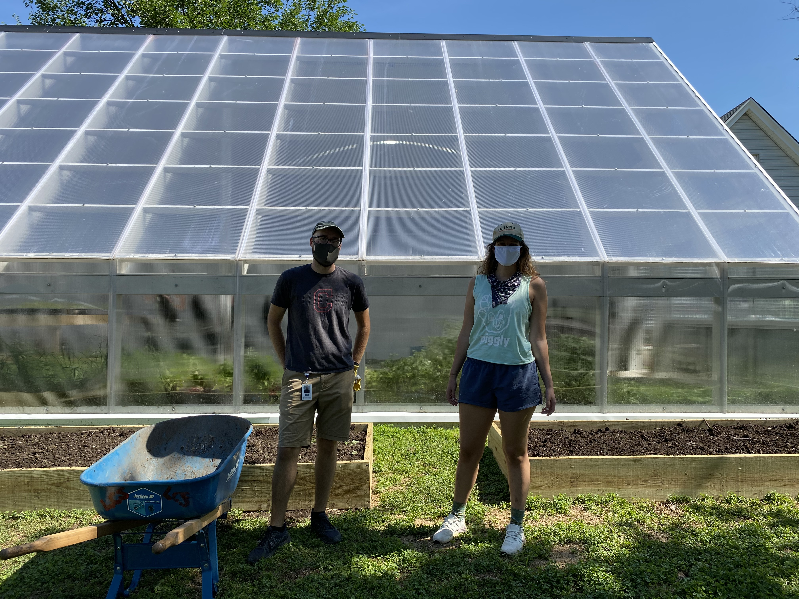
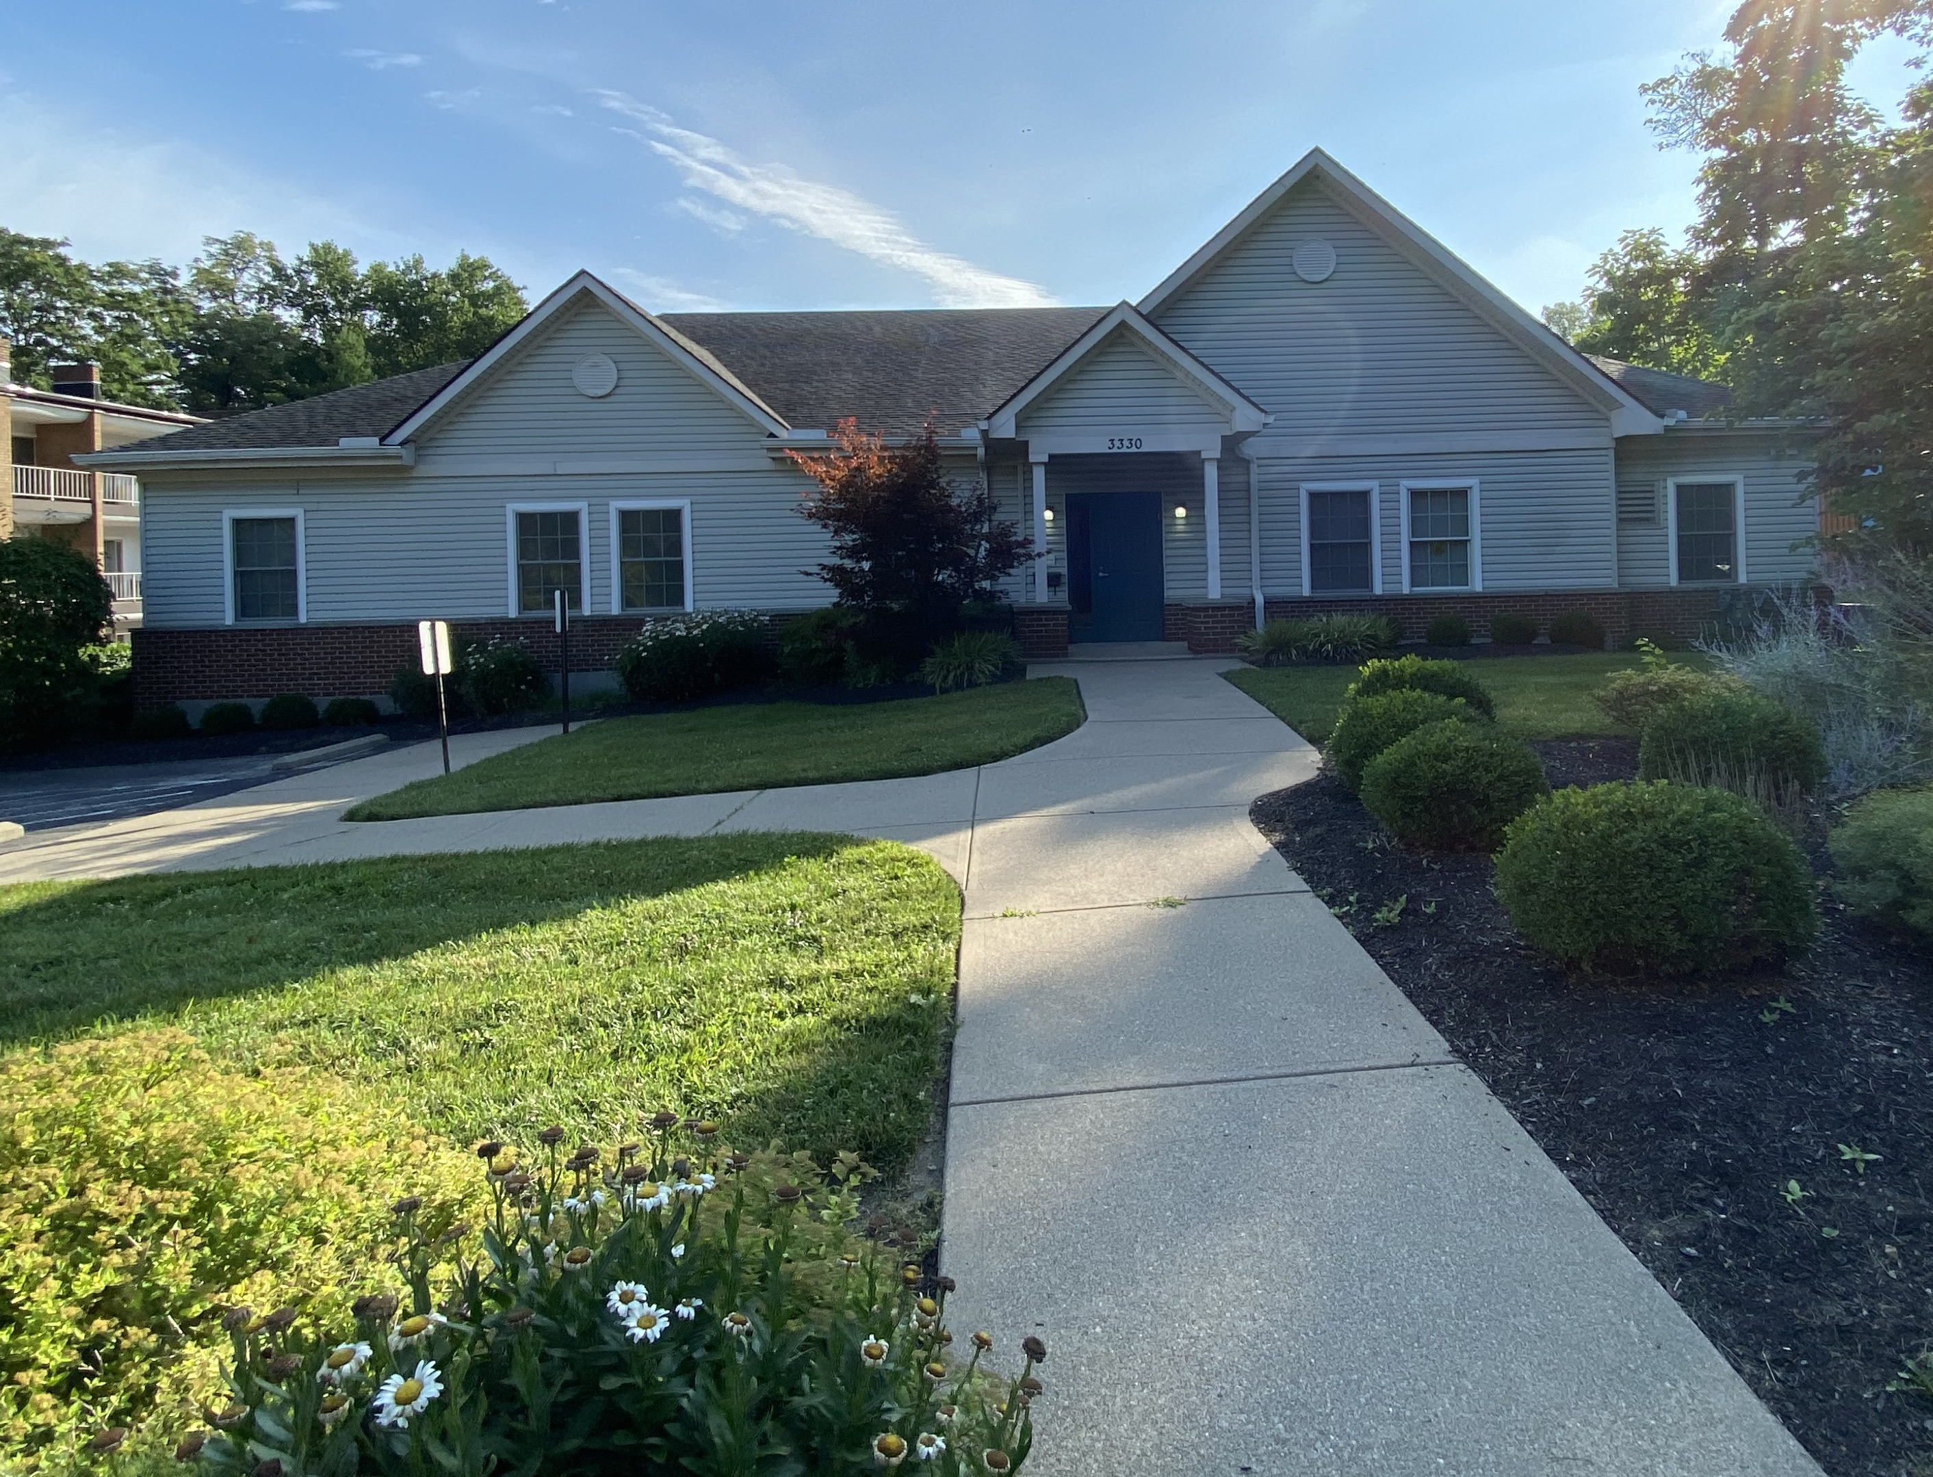
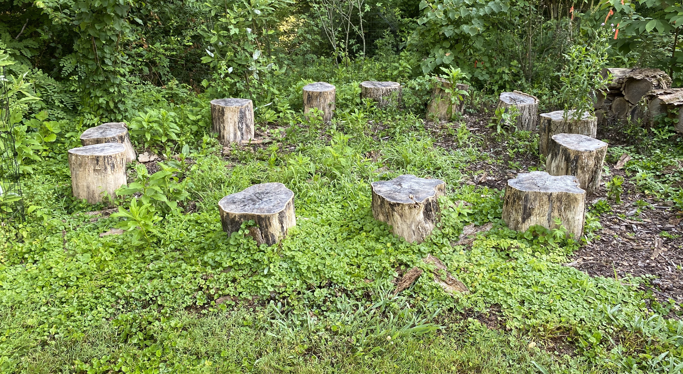
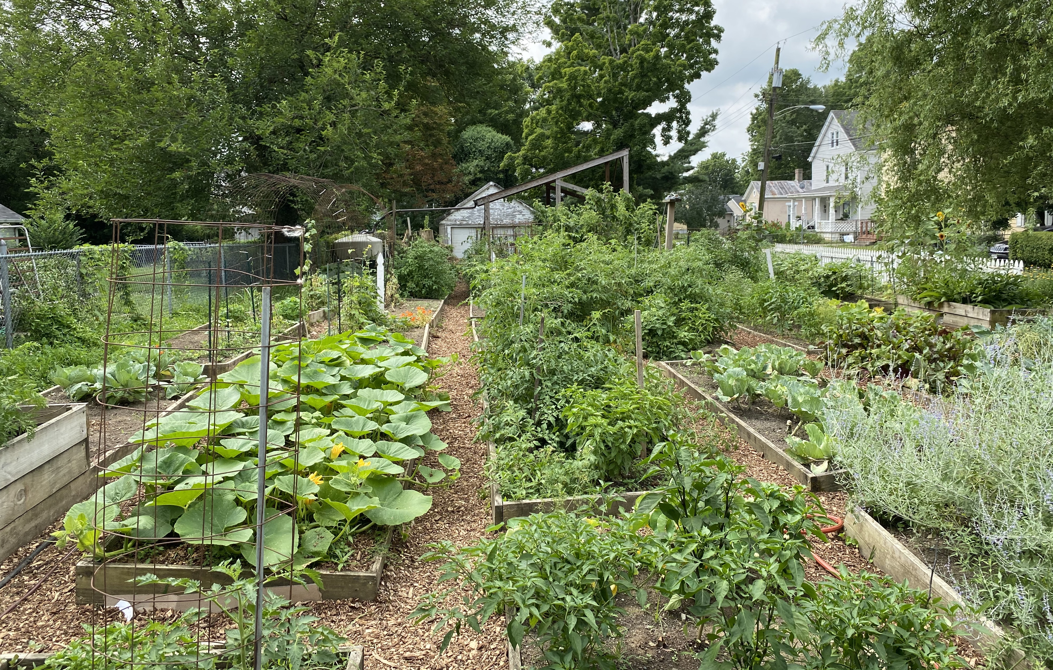
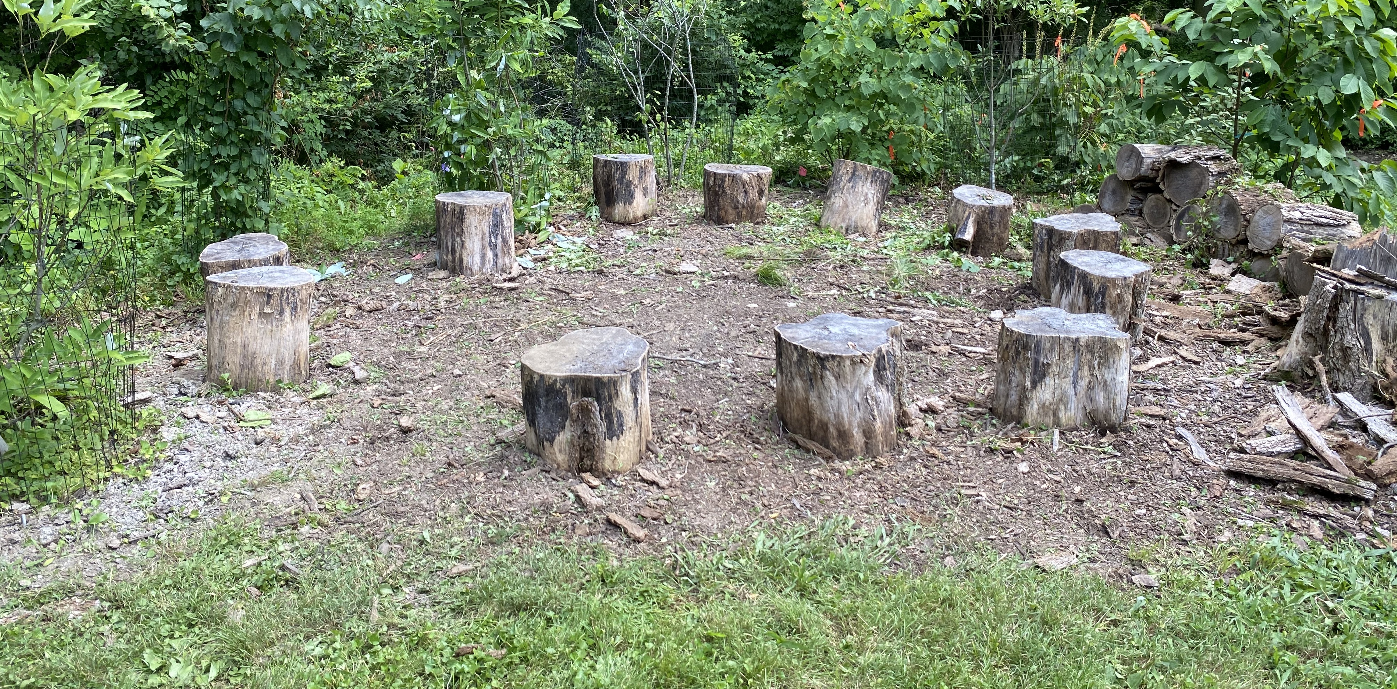
Lighthouse Youth Development Center
Jacob Waldruff, University of Cincinnati College of Medicine
What is YDC?
The Lighthouse Youth Development Center is a facility that offers a home for teenage boys who find themselves without one for a variety of reasons—from fleeing an abusive home to needing a place to live while navigating the criminal justice system. YDC cares for all the boys’ basic needs and helps them learn the life skills they will need in the future. The boys have individual and group therapy sessions and learn responsibility through chores and the summer work program.
Summer Work Program
The summer work program was the highlight of my time at YDC. It consisted of 4 hours of work 4 days per week for the boys. The boys were paid for the work and were expected to treat it like a real job to teach them the responsibility they will need for future jobs. For the program, we worked with an organization called Groundwork. The boys got to experience a wide variety of work—from maintaining community gardens to mulching wooded trails—and the best workers could be hired by Groundwork in the future. They also learned the importance of contributing to their community.
Project: Applying New Skills
I wanted to show the boys that they were capable of applying skills they learned on the job in other parts of their lives and encourage them to take ownership of something without an outside incentive. To do this, we started a small garden at YDC similar to those they worked on during the work program. The boys will get to eat whatever it produces, and my hope is to stay on as a volunteer with Lighthouse to help them maintain the garden this autumn and in future years. We also used the garden to discuss the importance of including plants in a balanced diet.
A Day in My Life at YDC
8 AM: got the boys ready to leave for the summer work program/summer school
8:30 AM – 12:30 PM: summer work program
1 PM – 1:30 PM: facilitated showers and lunch
1:30 PM – 4:30 PM: took the boys on outings, played games, or other miscellaneous tasks as necessary
5 PM – 6 PM: attended group therapy sessions twice weekly
Acknowledgements
First, I want to thank Eunice and Maddy for navigating UHP through COVID-19. I would like to thank Tony Frazier for taking time out of his days to coordinate my time with Lighthouse. I would also like to thank Alan, Tanner, and everyone else at Groundwork for helping us show the boys at YDC that gardening and community work can be fun and accessible. Finally, I want to thank all the great residents and staff at the Lighthouse Youth Development Center for a wonderful summer and all the lessons that came with it.
Impact of COVID-19
YDC has continued to operate throughout the COVID-19 pandemic with modifications to staff-resident interaction and health screening. YDC staff wear masks at all times and check their temperatures before every shift. The boys also wear masks when they leave YDC, though a major impact has been that the number of outings they go on is reduced this summer. They mostly consist of trips to parks and local high school outdoor sports facilities, with the occasional afternoon of swimming.

Slide 11
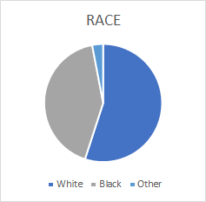
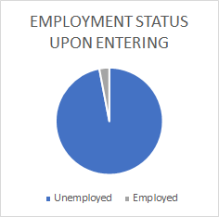
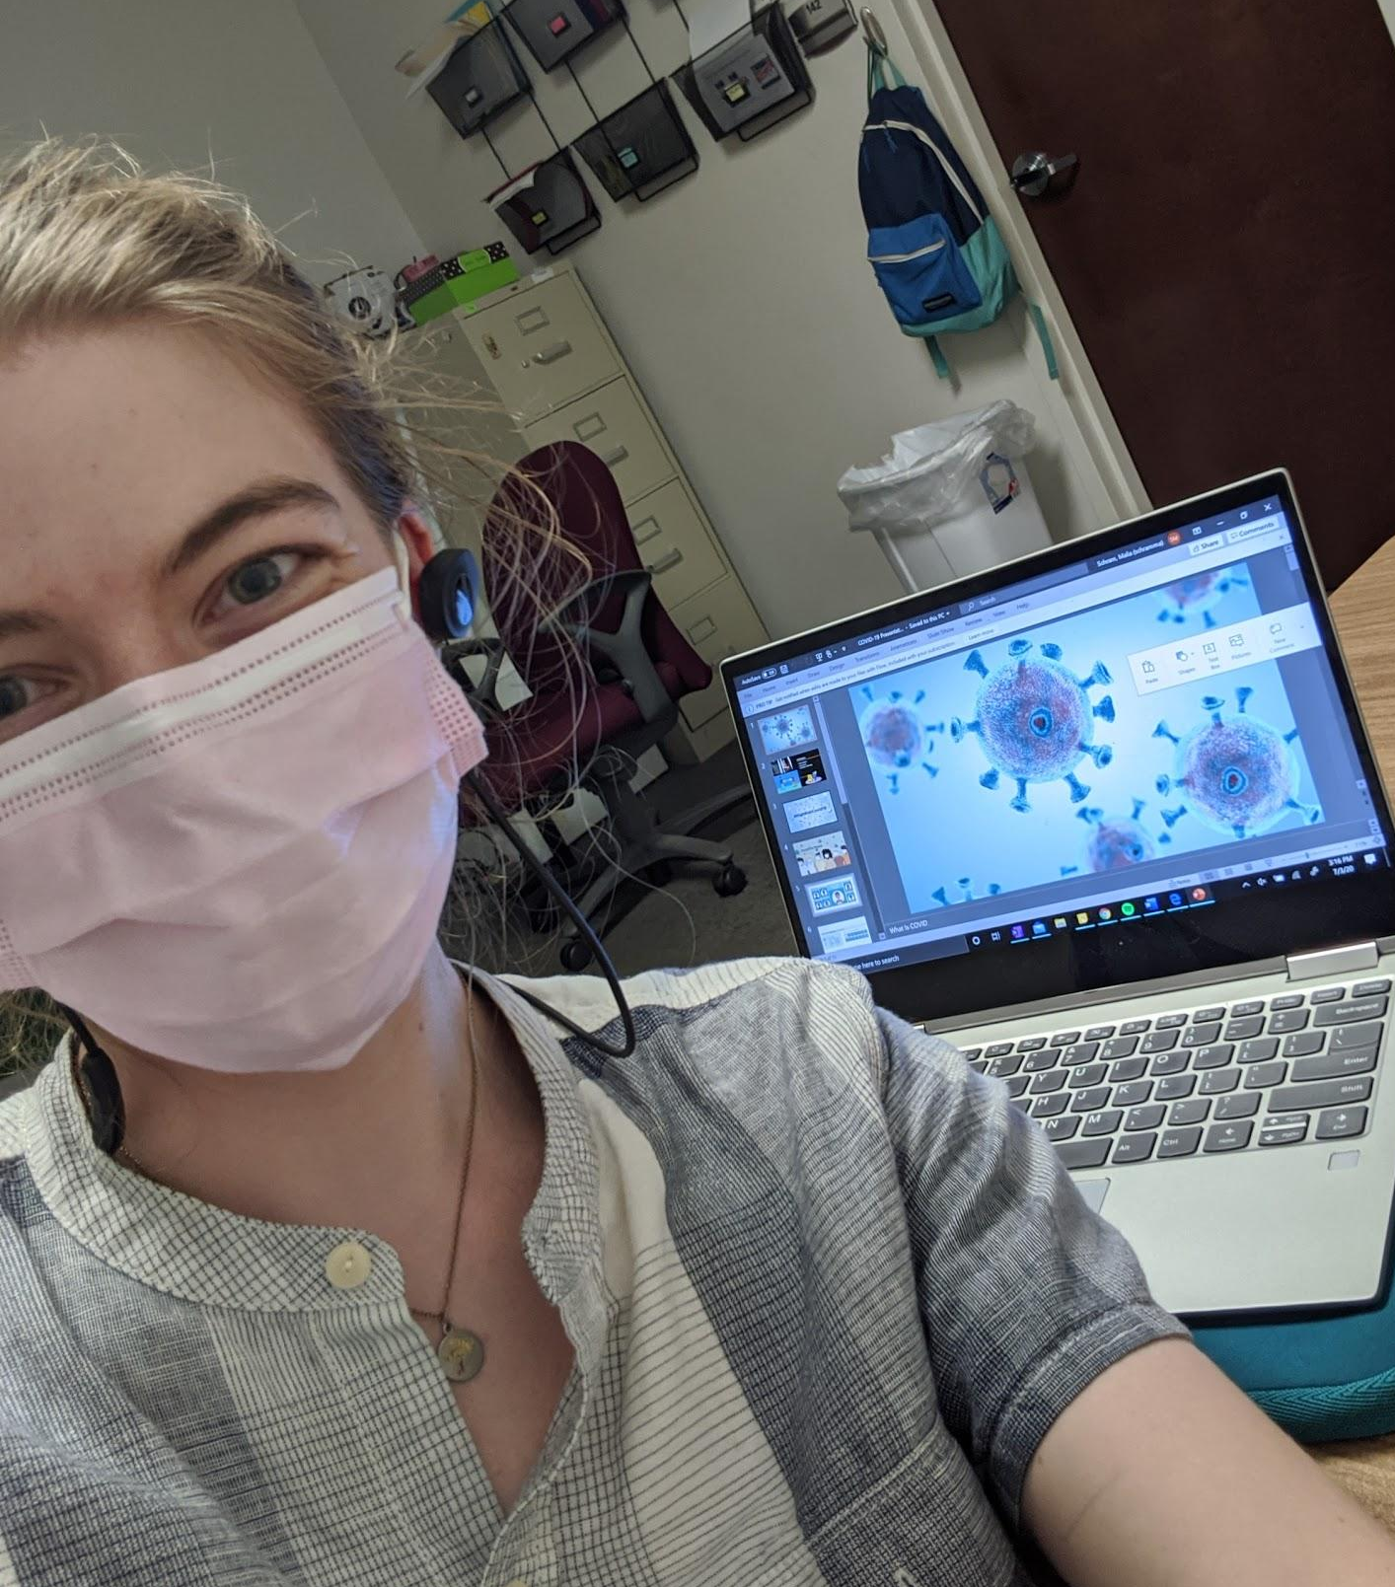
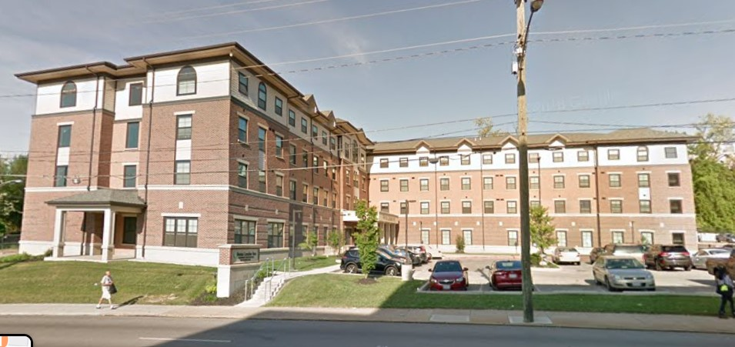
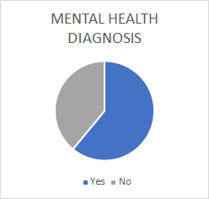
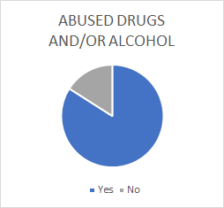
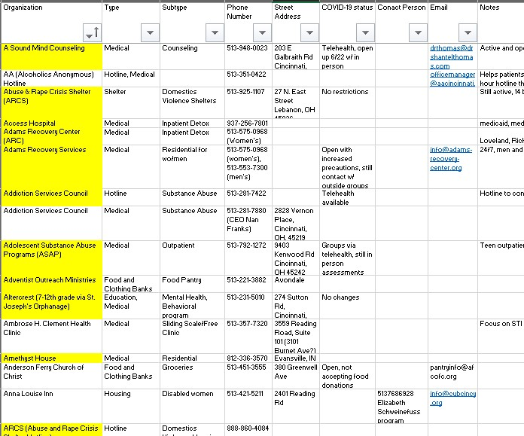
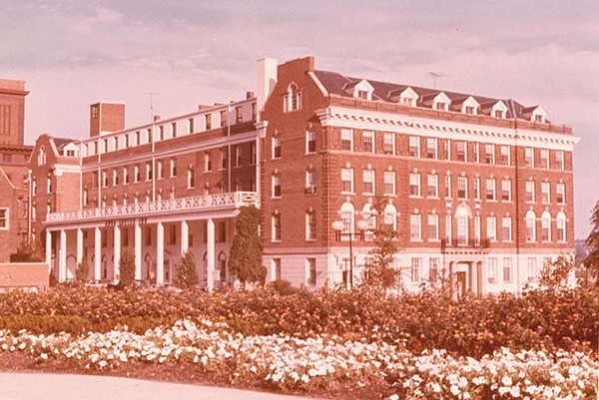

Off the Streets - Cincinnati Union Bethel
Malia Schram, University of Cincinnati College of Medicine
About OTS
OTS is a residential shelter for women with histories of sex trafficking and exploitation
Three phase program without a time limit
Utilize a culturally sensitive, trauma informed, peer-based model
Focus on recovery and providing services to reduce harm and support growth
Each client has a case manager and receives substance abuse treatment
OTS Demographics
Project: Resource Guide and Health Education
The center has not had a singular resource guide since moving into their new building. They have struggled to maintain a consistent, updated, and centralized list
Additionally, much of the regular educational programming was cancelled due to the pandemic
To fill these need gaps, I have worked on a 400+ organization resource list, calling each site for updated information
I also created a four session health education curriculum, focusing on COVID-19, sexual and mental health, and addiction neurology
History of OTS and CUB
Longest continuously operated social service agency in Cincinnati
Since 1830
Clergymen offered religious services and literature to crewmen
Bethel is a church for sailors
Off the Streets founded in 2006, serving over 800 victims of trafficking
Summer Internship
Worked primarily from home, though I initially worked on site 2-3 days per week
Tasks included organizing current resource list, taking temperatures of returning residents, assisting with daily tasks, and working on presentations
At OTS, the women are independent and have a semi-structured day, with a morning check in and other educational events
Acknowledgements
I would like to thank Elizabeth Schweinefuss and Viann Barnett for coordinating the Urban Health Project internship and educating me about trafficking services and all the kind and thoughtful residents at OTS. I would also like to thank Ben Hood for collaborating on the resource guide with me. Finally, I would like to thank Eunice Agyapong and Maddy VandenBrink for their incredible support this summer.

Slide 12
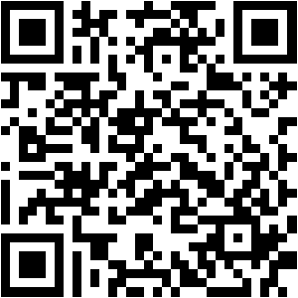
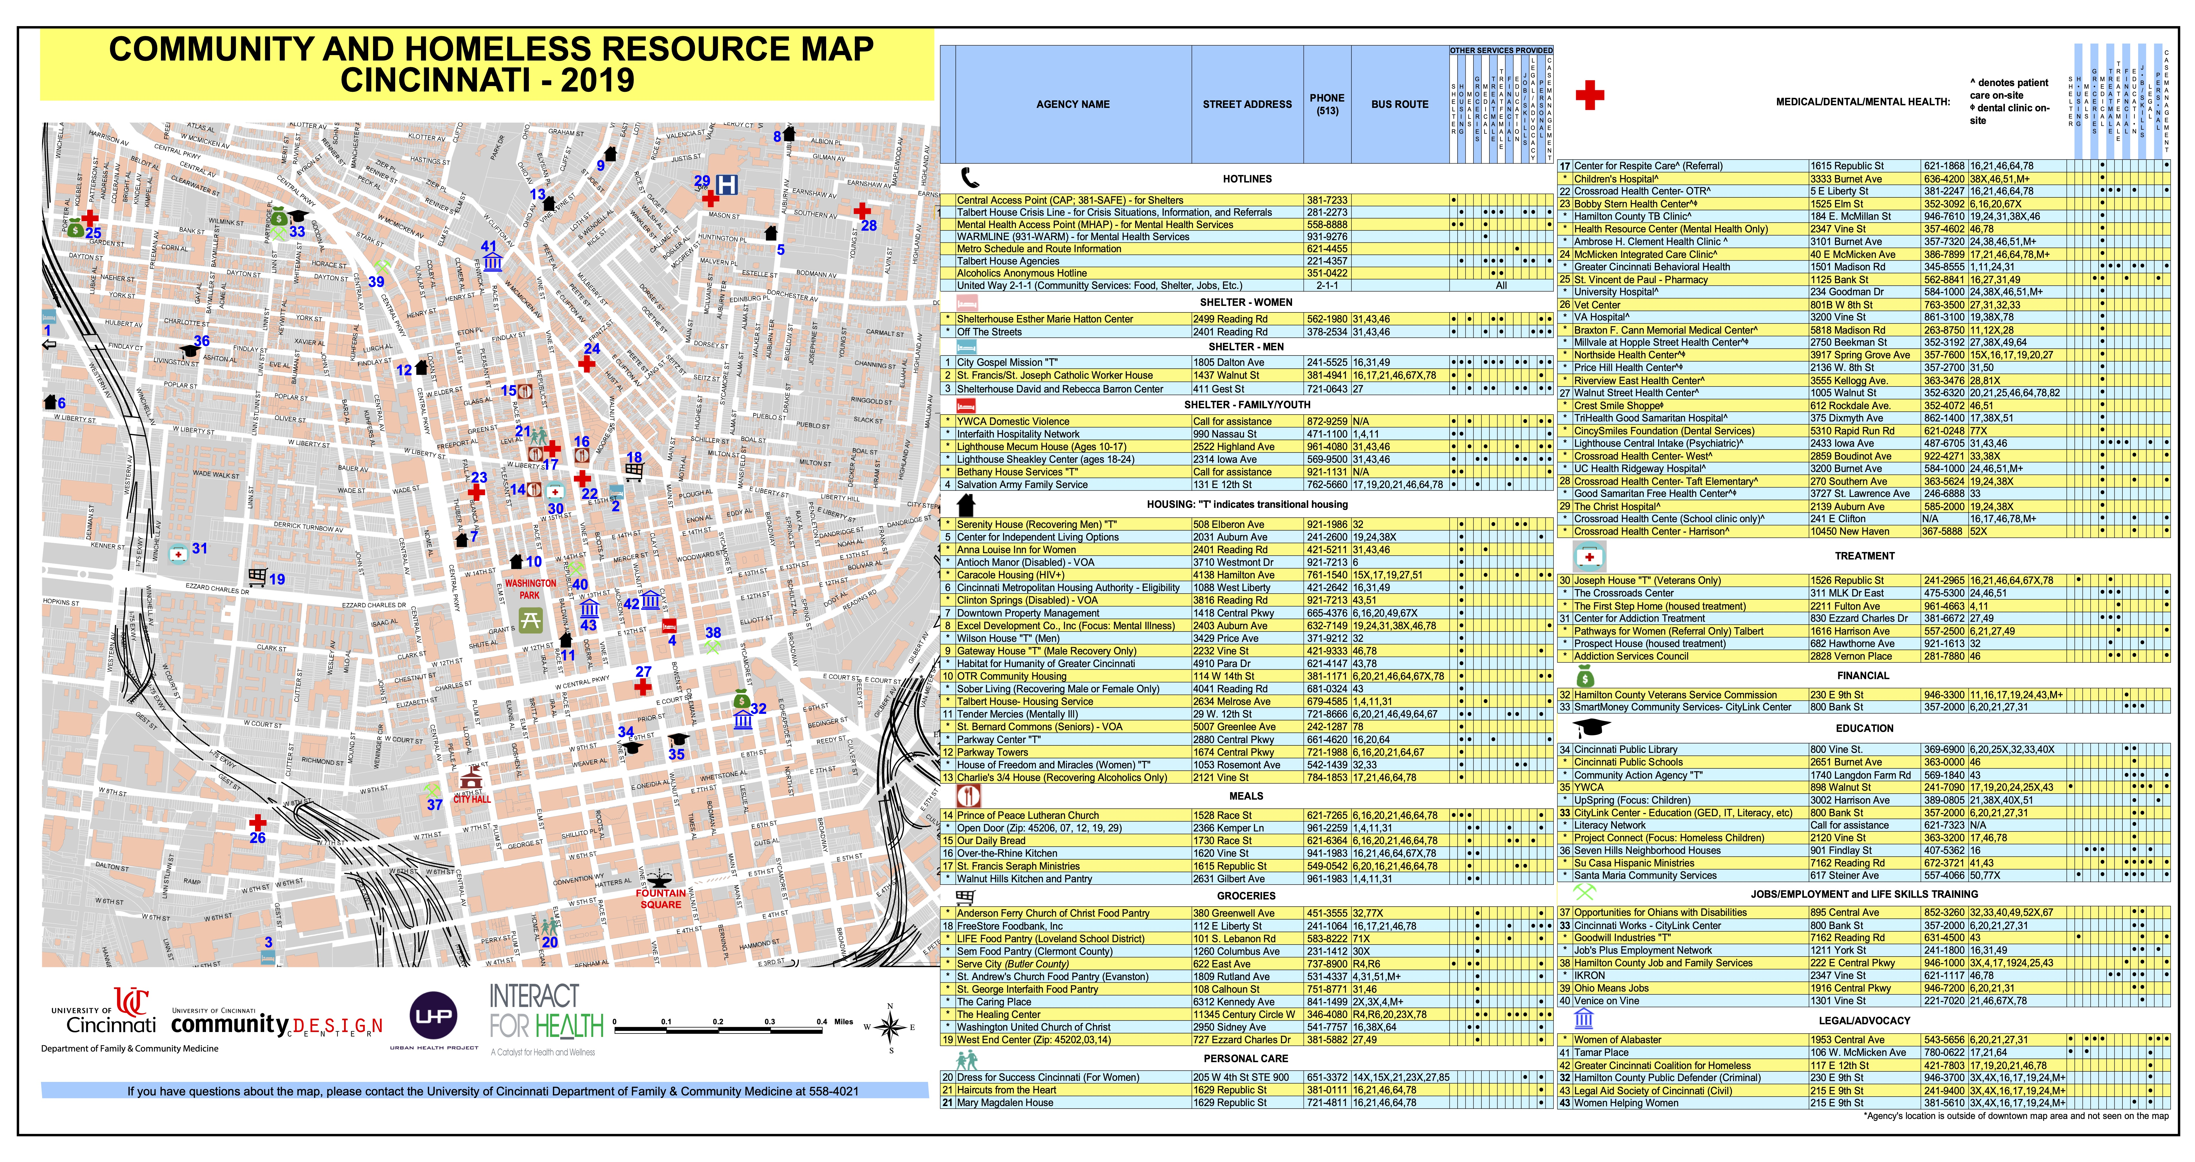
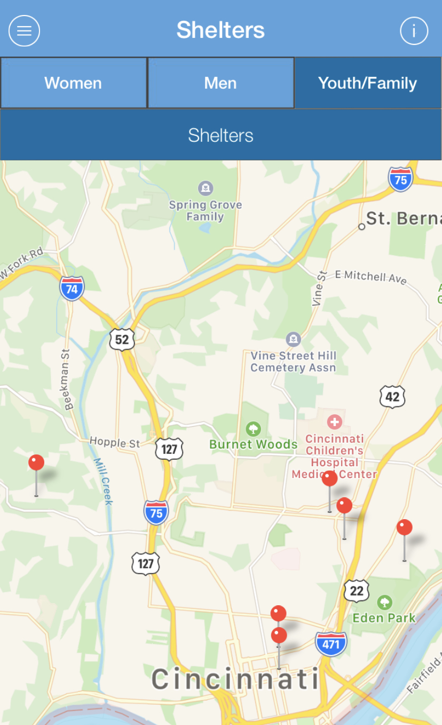
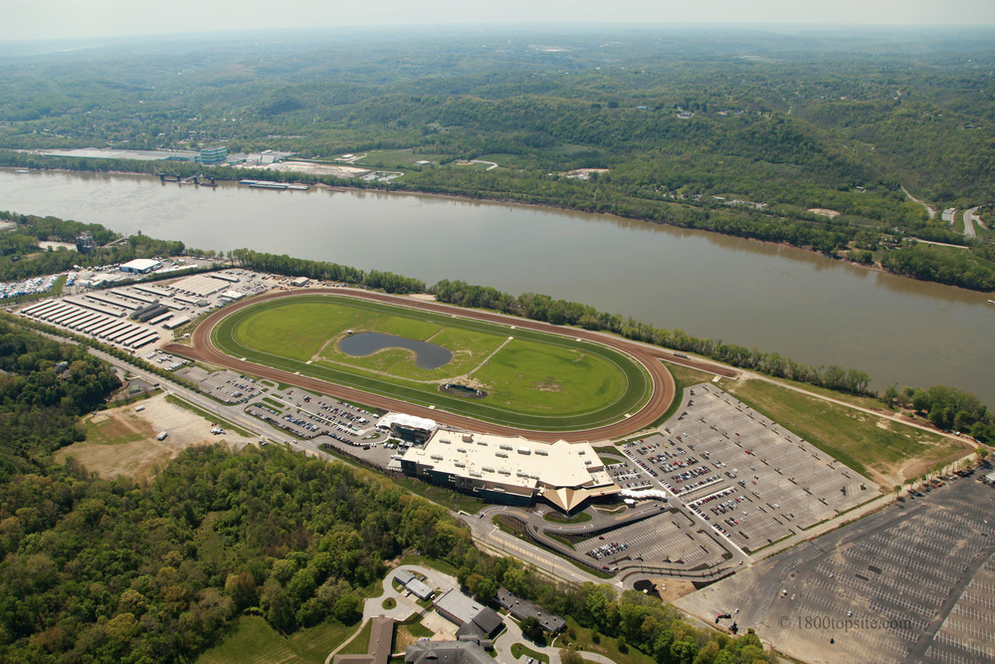
UC Family and Community Medicine Racetrack Clinic
Ben Hood, University of Cincinnati College of Medicine
Project Aims
Increase engagement with health-related resources in Cincinnati
Maximize accessibility and ease of use
Distribute directory information widely
Map
Updated to reflect permanent changes to services
Includes new programs and community partners
Shared with community partners for wide distribution of knowledge
App
Designed to reflect the most up-to-date information from the directory map
Includes additional information like meal dates and times (kitchens)
Search and navigation functions increase utility
Clinic
Opportunity to treat patients with limited access to healthcare
Weekly frequency and prescription delivery ensures patient engagement
Patients can provide feedback on map and app to improve the resource for everyone
Challenges
Many social services have temporarily or permanently reduced staffing and/or programming
Temporary changes to programming difficult to reflect in annual resource
CHD health centers, while open, have limited availability to discuss changes
Acknowledgements
I would like to thank Dr. Kiesler for organizing our project goals and priorities and providing me with meaningful opportunities to engage with patients during a challenging public health crisis. I would also like to thank Dr. Rosenthal and the residents who volunteer their time at the racetrack clinic and demonstrate excellent clinical practice. Finally, thanks to Malia Schram, Alex Gillotte, and all prior and current UHP interns who contributed to the information reflected in this resource.

Slide 13
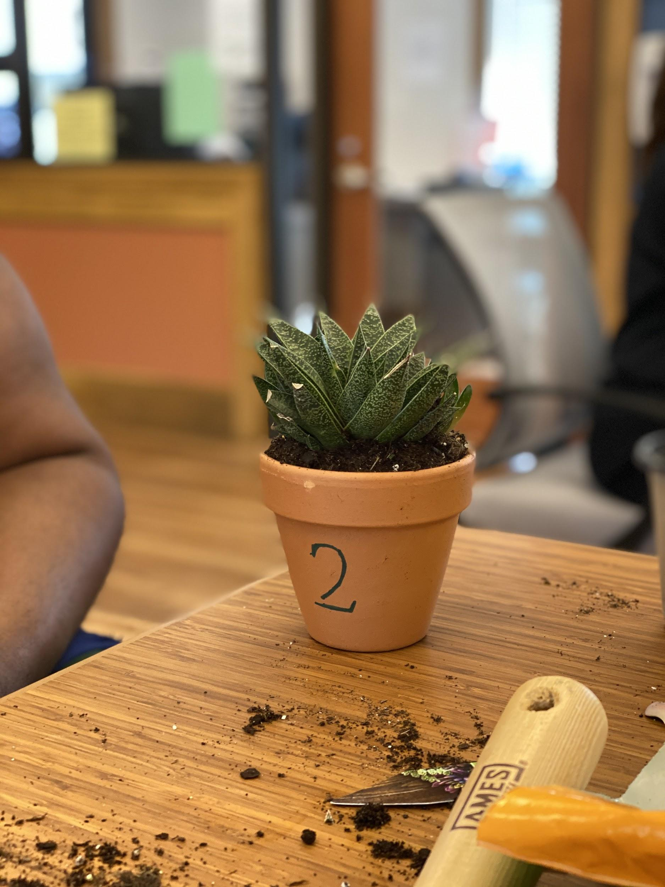
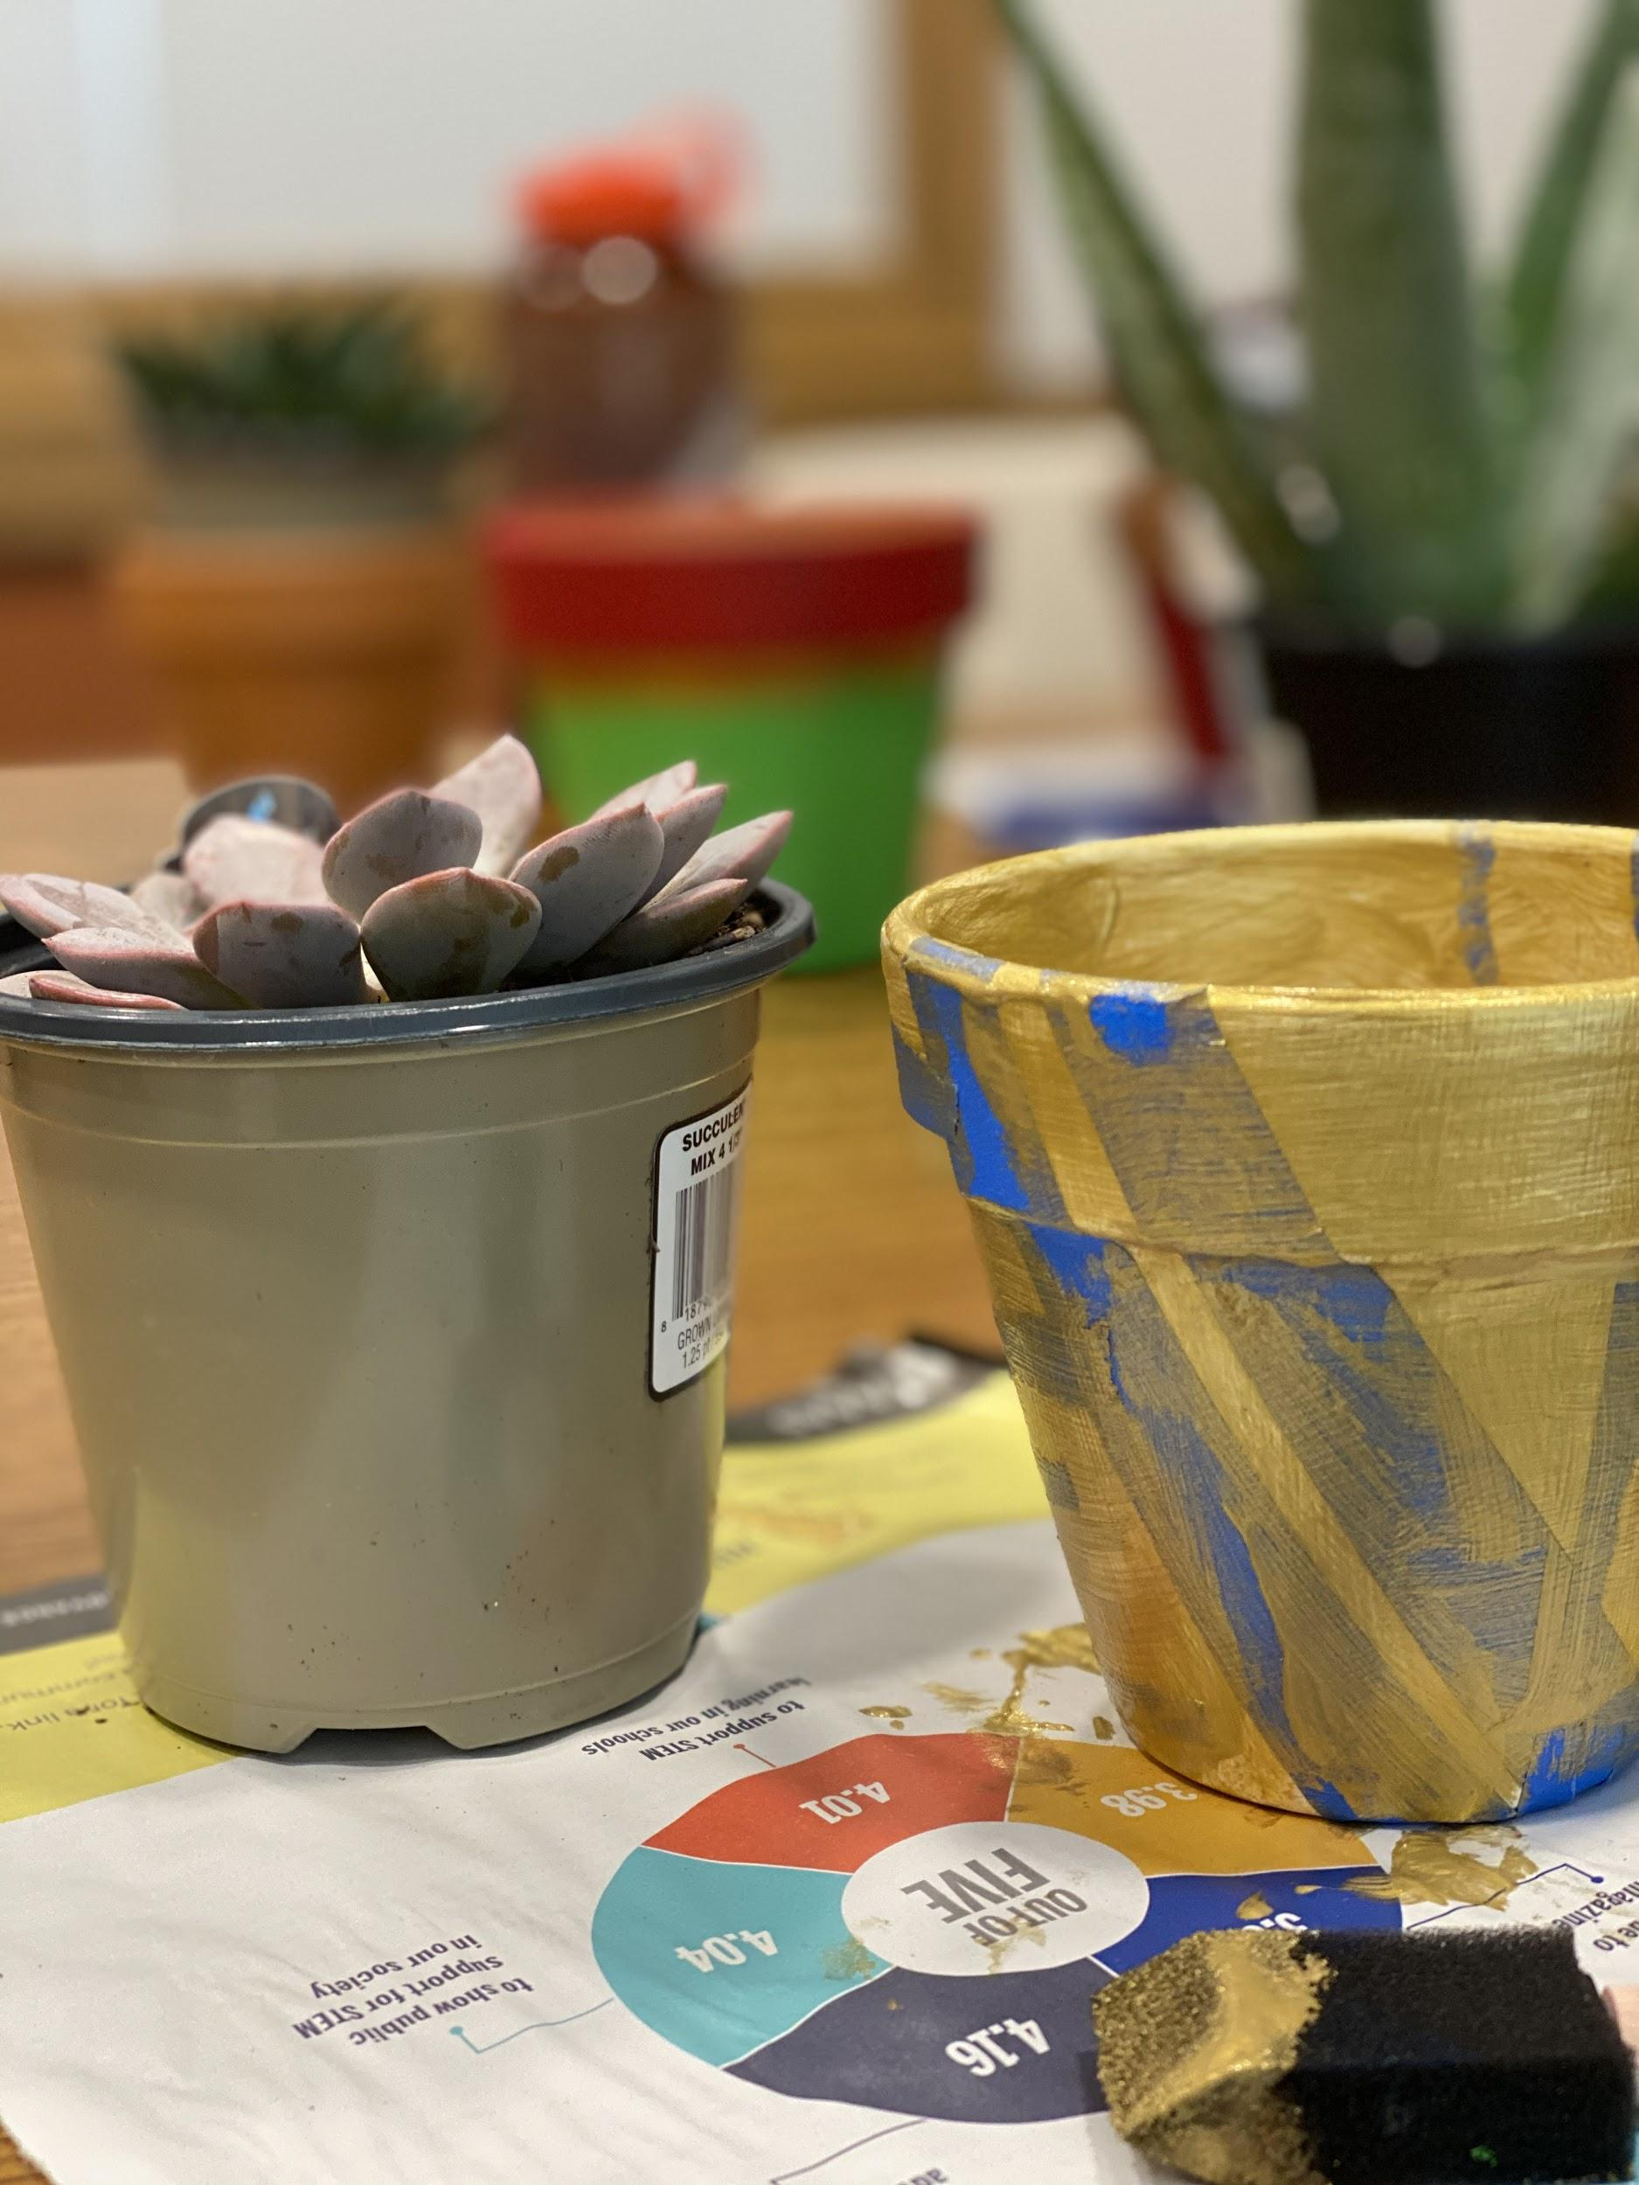
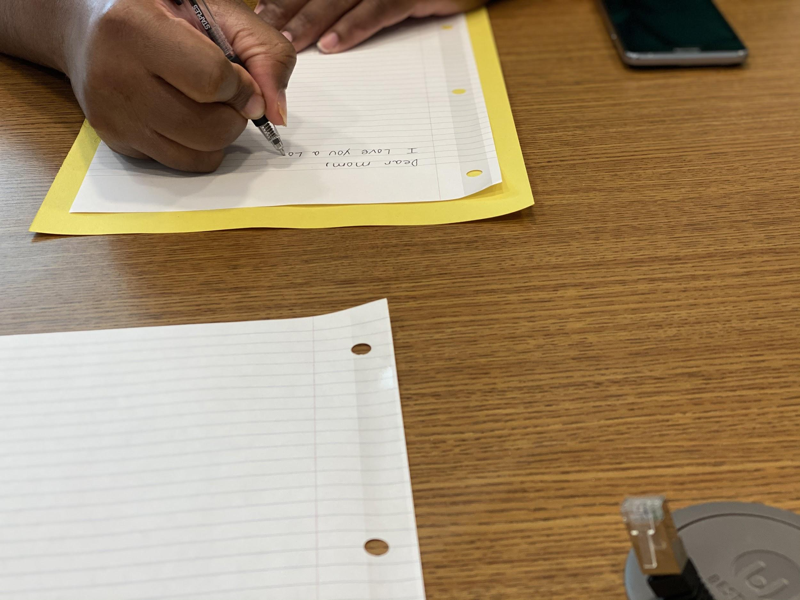
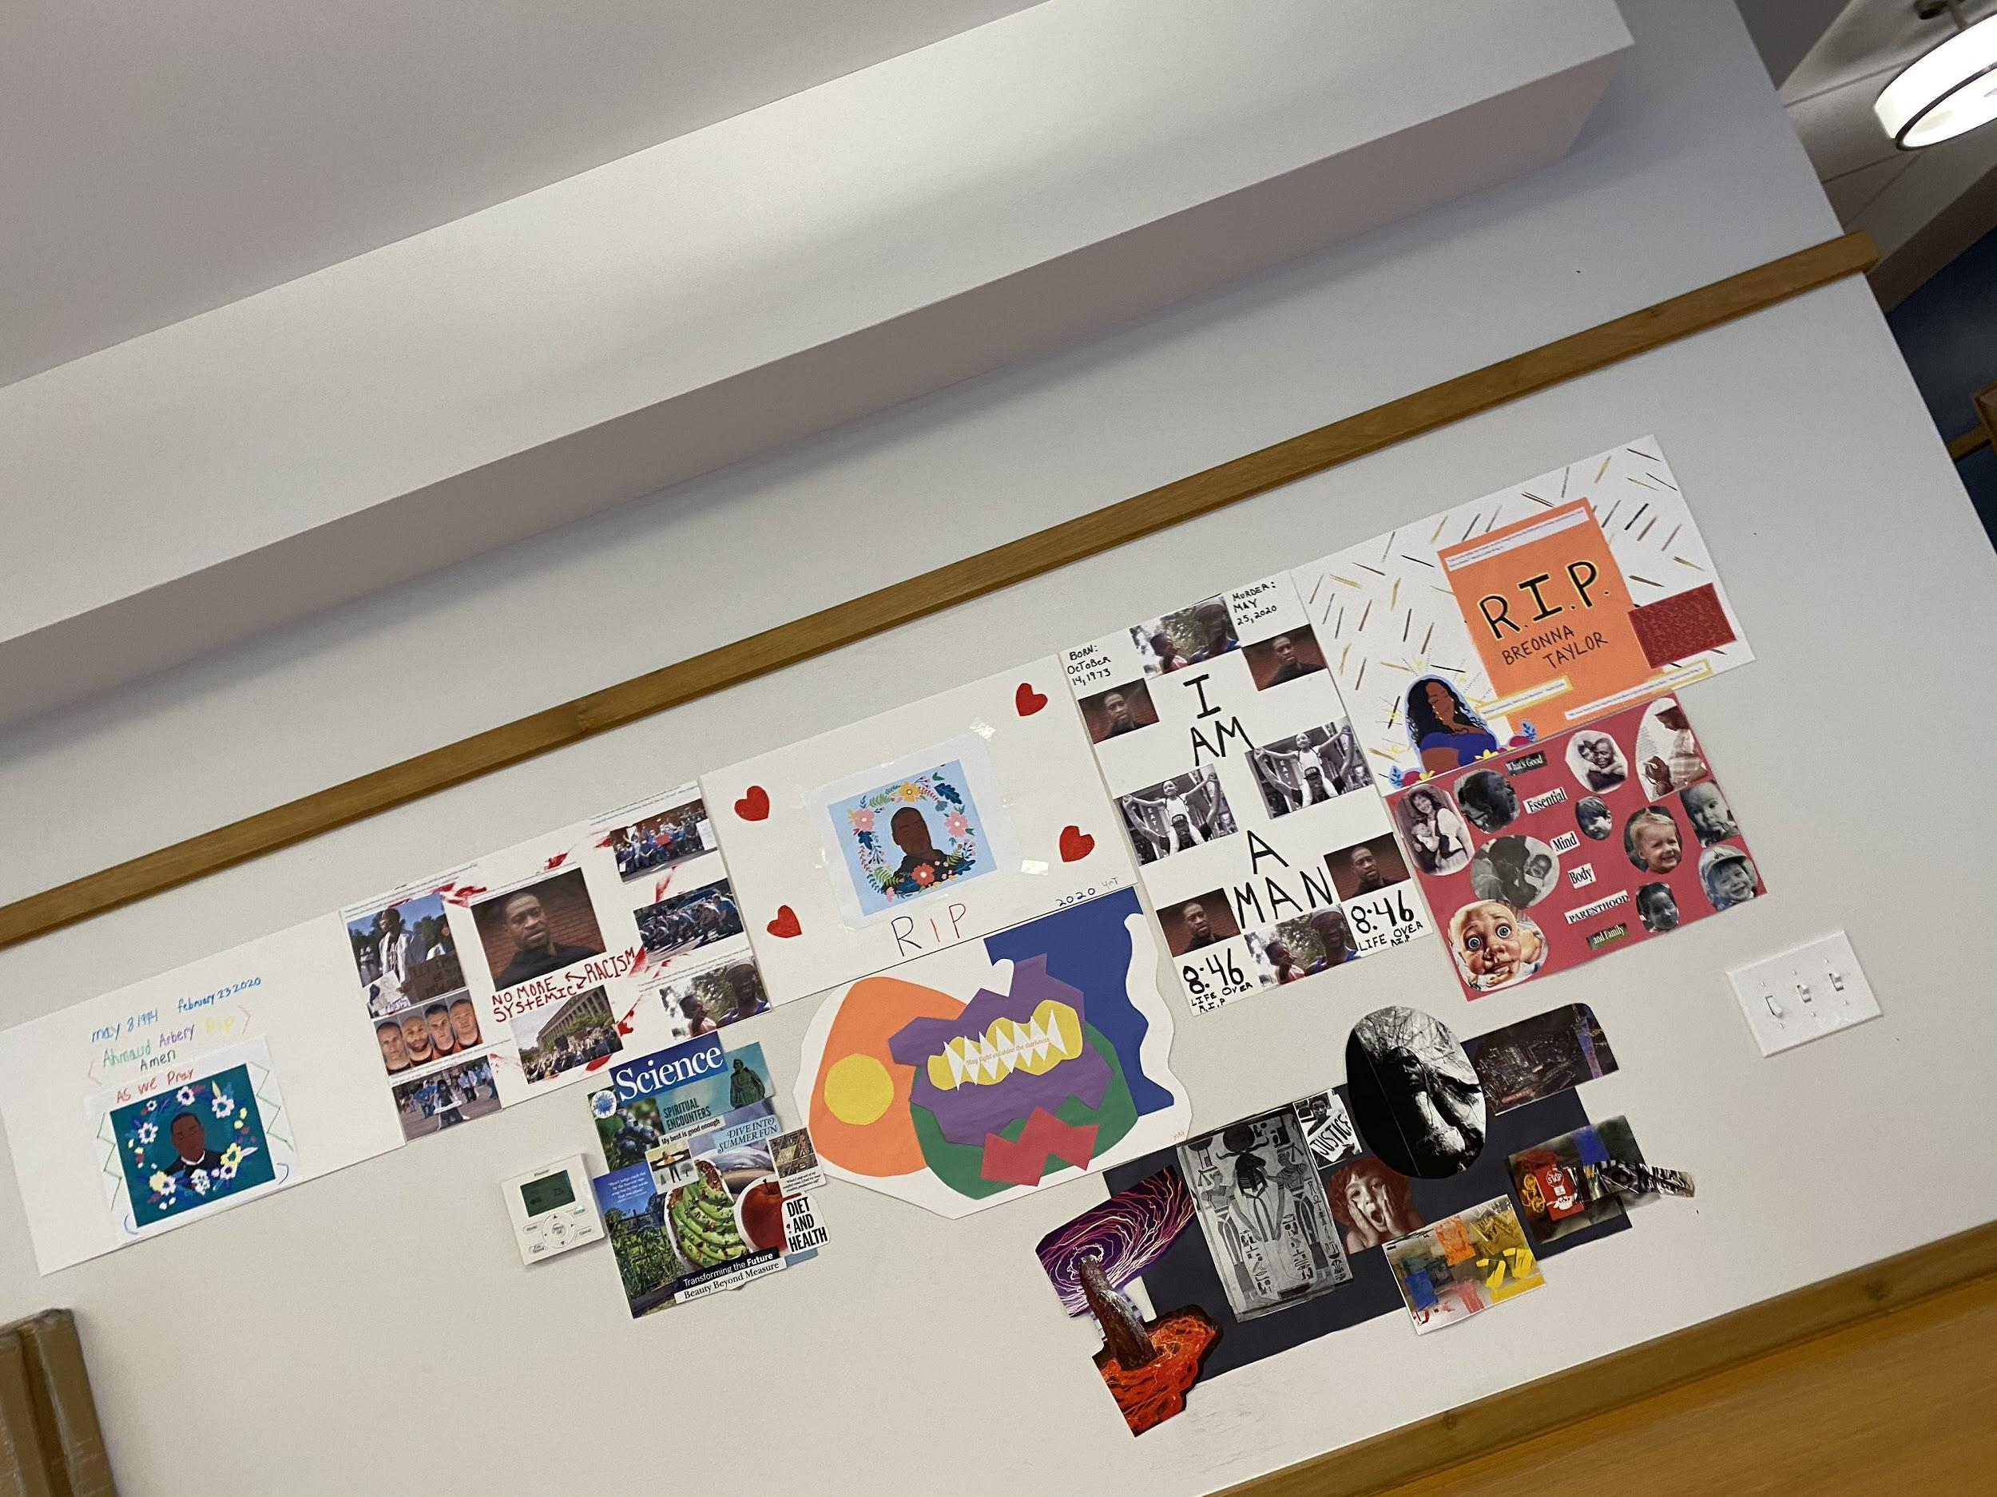
Tender Mercies Urban Health Project Experience
Annamarie Nocera, University of Cincinnati College of Medicine
Tender Mercies
Tender Mercies transforms the lives of homeless adults with mental illness by providing security, dignity,
and community in a place they call home.
Newest building is 821 Flats, where UHP Project Intern was stationed.
58 residents of various backgrounds in 821 Flats.
People do not need to be sober or clean to stay at 821 Flats.
Project: Activities to Improve Mental and Physical Health
Each day, I provided an activity that related to mental or physical health.
Activtiies included cooking class, values journaling, mindfulness jar making, tribute poster and discussion for current events, etc.
UHP funding was used for plants for the residents. They decorated the pots and were instructed how to care for the plants.
Challenges and Learning
In group settings, one resident was extremely intrusive (interrupted once every few seconds to talk for an indefinite amount of time) and this made leading groups hard.
After finding out that a majority of people weren’t attending my groups because they did not want to be around the resident, I responded more firmly to their excessive interrupting, which the resident responded well to.
Many of the men-appearing people often commented on my appearance, calling me pretty.
At first I was slightly bothered by this but did not ay anything, and by the end I found myself feeling much better if I told them sternly that this was unacceptable to me and explained why it felt degrading, even if it didn’t change the outcome.
Overall, Mary Grover, my supervisor, did a wonderful job at framing many of their issues as forms of suffering, which helped me act more compassionately.
Socially Distant Walks
Walked with residents each morning at 10:00 am M-F.
Provided a low stress environment for sharing any challenges the residents were facing
For the final week of the summer, we decided to stop walking as a group, as socially distancing became more difficult. Residents are encouraged to walk on their own.
Acknowlegements
I would like to thank Mary Grover, Maddy VandenBrink & Eunice Agyapong for their support and assistance this summer.
Typical Day at TM
10:00-11:00 AM: socially distant walk with residents
11:00-2:00 PM: various activities, including planning activities, chatting with residents 1:1 or in groups.
2:00PM- 4:00 PM: lead group activity related to physical or mental health, or fun craft.
4:00 PM- 6:00 PM: pick up supplies for the next day at the store, plan activities, put up signs for tomorrow’s activity.

Slide 14
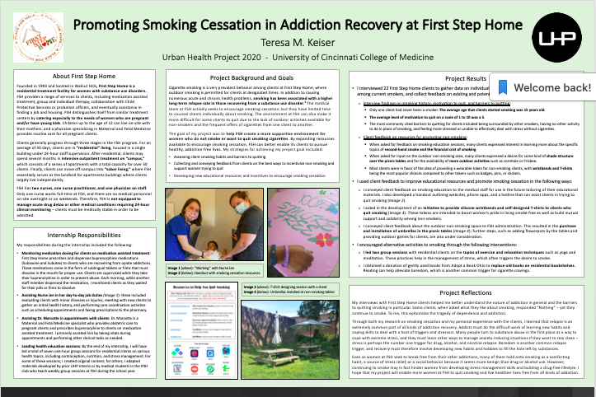

Slide 15
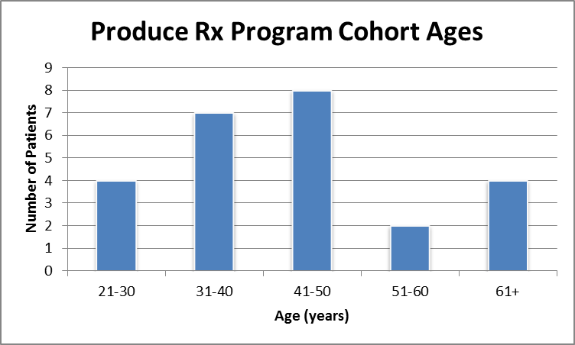
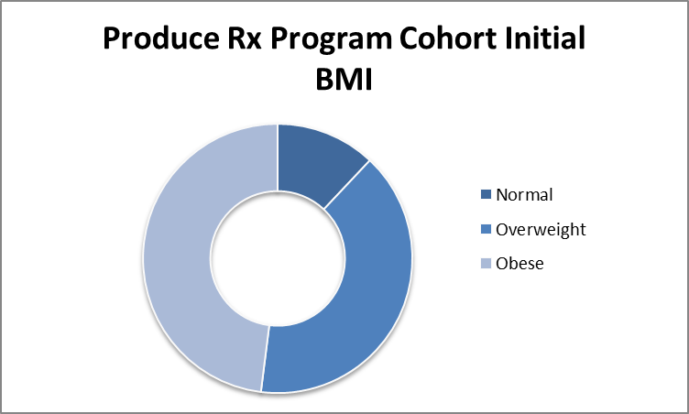
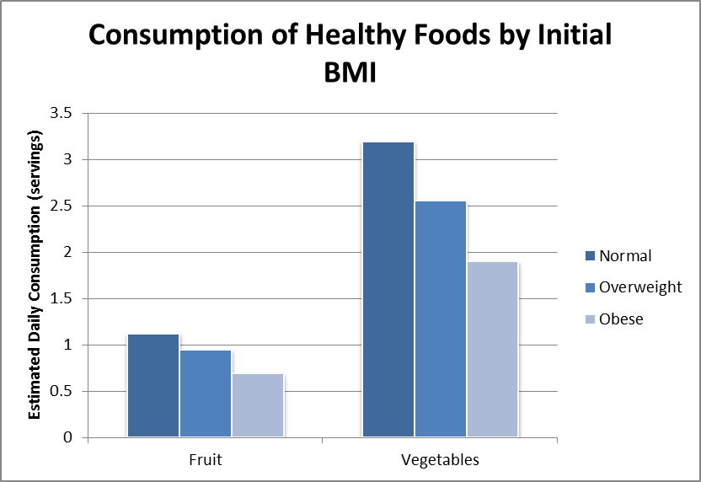
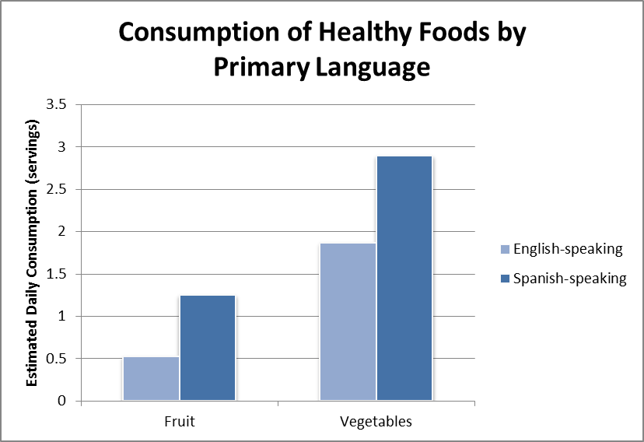
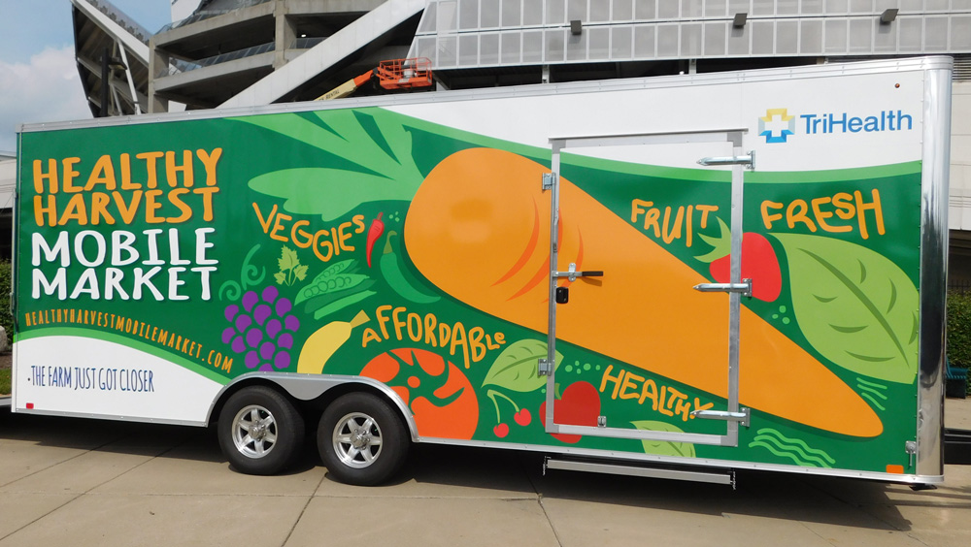
Addressing Food Insecurity with a Produce Prescription Program
Evan Gies, UCCOM Class of 2023
ABSTRACT
The objective of this project is to address food insecurity in the patient population of Good Samaritan Free Health Center by improving access to healthy food. Patients were screened using validated questions, and we collected demographic and health information to characterize the food insecure population. Those who screened positive and chose to enroll receive one $15 voucher each month for nine months to the Healthy Harvest Mobile Market. This study discovered that the Spanish-speaking and the low BMI patients had better eating habits with fruits and vegetables.
INTRODUCTION
The objective of this project is to address food insecurity in the patient population of Good Samaritan Free Health Center by improving access to healthy food. 33% of families in Cincinnati suffer from food insecurity (DeMartini et al, 2013). Patients were screened using validated questions, and we collected demographic and health information to characterize the food insecure population. Those who screened positive and chose to enroll receive one $15 voucher each month for nine months to the Healthy Harvest Mobile Market. This study discovered that the Spanish-speaking and the low BMI patients had better eating habits with fruits and vegetables.
METHODS
Every in-person patient visit includes two quick screening questions about the patient’s 1) food scarcity and 2) worry of running out of food. If the patient screens positive, they are offered the Produce Prescription Program where they receive $15 for produce every month for one year. Enrollees are asked six questions about their weekly fruit and vegetable intake, which is used to calculate the Estimated Daily Consumption (EDC). Also collected are the patient’s age, language, BMI, Blood Pressure, and A1C. Each month, the amount of produce prescriptions redeemed will be reported to assess participation. At the end of June 2021, the patient’s statistics will also be recorded again.
RESULTS
The results of the study are ongoing as more patients are recruited and as the data is collected on participation and overall health outcomes. To date, there are 25 patients enrolled. 44% of the patients enrolled are Spanish speaking. Table 1, Figure 2, and Figure 3 show key demographics and statistics on the enrolled cohort. Figures 3 and 4 show early trends found in the data.
DISCUSSION
The results of the patient cohort in the Produce Prescription program show that in general, Spanish-speaking patients and patients with lower BMIs tend to eat more fruits and vegetables per day. The sample is also representative of the patient population at the clinic, with 56% of the cohort speaking English compared to about 50% in the patient population.
The main reason patients turn down the program is transportation. Patients are also embarrassed about their food situation, which may sway patients to refuse the program when they might benefit.
CONCLUSION
Data will be collected on participation throughout the year
Data will be collected on the cohort at the end of the program
If there are positive results of the program, we hope to apply for more funding to extend the program to more patients
ACKNOWLEDGMENTS
Thank you to Annie Klapheke and Kyla Maddox for organization and coordinating this project. I would also like to thank Linda Smith-Berry for her guidance and support throughout my time at the clinic. I learned a lot this summer from watching the staff of the Good Samaritan Free Clinic work tirelessly to adapt to the changing COVID-19 situations with the patients always in mind. Finally, thank you to the UHP and the UHP directors for their support and coordination of my summer project.
Table 1. Average Body Mass Index (BMI), Blood Pressure (BP), Hemoglobin A1C and Daily fruit and vegetable consumption for the enrolled patient cohort.
BMI | BP | A1C (if diabetic) | Daily Fruit Servings | Daily Vegetable Servings
31.51 | 123/75 | 7.5% | 0.8 | 2.3
Figure 1. Age distribution of the first 25 patients enrolled in the Produce Prescription Program. Ages are spread across the range of patients seen in the clinic.
Figure 2. BMI Distribution of the first 25 patients in the Produce Prescription Program.
Figure 4. Daily consumption of fruits and vegetables by initial BMI. Lower BMIs tend to eat higher portions of fruits and vegetables.
Figure 3. Daily consumption of fruits and vegetables by preferred language. Spanish-speaking patients tend to eat higher portions of fruits and vegetables than English-speakers.
https://spotlightdirect.com/marketing/healthy-harvest-mobile-market/

Slide 16
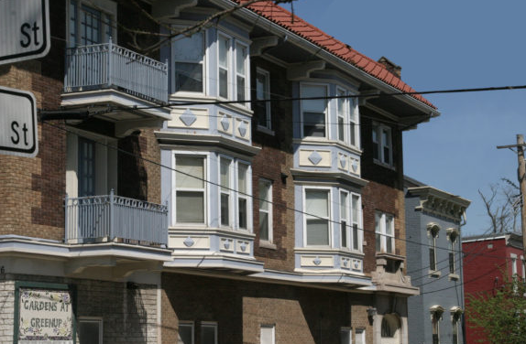






Welcome House Emergency Shelter of Northern Kentucky
Kiersten Woodyard, University of Cincinnati College of Medicine
About Welcome House
Welcome House Northern Kentucky is an emergency homeless shelter for women and children that utilizes the low-barrier model.
It is an emergency shelter for temporary stays with the goal of the rapid re-housing of the residents.
Presently only able to provide housing to around ⅓ of capacity due to Covid-19, around 16 women and 1 child total currently are staying at the Welcome House Emergency Shelter.
Life After Welcome House
In 2018, 73% of residents exited the emergency shelter to positive housing outcomes
In 2018, 68% of residents had an income at exit
In 2018, 42% of residents increased their income after leaving shelter
96 households were served with rental assistance, which shortened their stay at Shelter and also maintained positive housing outcomes
Project: Treating Common Ailments at Home and Nutritional Cooking
I created an educational resource for the shelter on how to treat common ailments at home
This included information such as the viral nature of the common cold, and explaining why antibiotic treatment will not be effective
It also included reproductive and sexual health information
The residents at Welcome House are often adverse to anything green, so we made tacos and guacamole to expose them to new food
We also discussed nutritional needs and reading food labels
Low-Barrier Model
While some shelters may require sobriety or a clean drug screen, Welcome House does not require either in order for a resident to be able to stay at the shelter.
While residents are asked to not bring in any drugs or alcohol to the shelter in order to support other resident’s sobriety, they will not be asked to leave if they are found to be intoxicated when entering shelter for the evening.
The low barrier model focuses on removing as many disqualifying factors as possible for residents in order to allow more people to access emergency housing services.
Rapid Re-Housing
The Rapid Re-Housing Program provides rental assistance so that individuals and families can move quickly from a shelter or living on the streets into an apartment of their own. While at Welcome House, residents work with a case worker to qualify for and transition to more stable living situations, including Section 8 homes and other low-income housing opportunities. Welcome House case workers assist residents with locating housing that fall under these programs.
Guests of the shelter work with Welcome House staff to increase income and access affordable housing while removing any challenges or barriers to success. Welcome House staff also assists residents with finding employment and saving money while getting started with new jobs and establishing benefits.
After clients move into their new housing, Staff at Welcome House continue to meet with them to ensure they keep or increase their income and understand their responsibilities in order to maintain the housing.
Health Literacy Counseling
While working at Welcome House this summer, one of my main duties was to help residents improve their health literacy.
Helped residents learn to read their prescription bottles and schedule their medication regimens
Taught residents how to look up health information on the internet, what are some good websites to visit
Would help residents understand their discharge papers and After Visit summaries after their doctors’ visits
Helped residents make doctors appointments, find PCPs, and set up telehealth appointments
Acknowlegements
I would like to thank Bev Merrill for welcoming me to Welcome House NKY and teaching me about homelessness. I would also like to thank Melissa Blanton and Candice Sy for helping me learn effective strategies to empower women who are experiencing housing instability.

